Slide 1
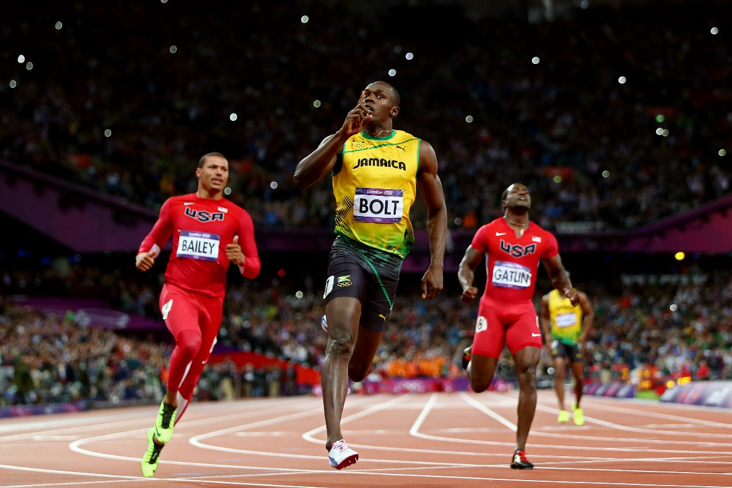

UNIT 1 & 2 − Exercise Physiology 2nd ed.
www.flickr.com/photos/az1172/3841143960/

Slide 2
UNIT 1 & 2 − Exercise Physiology 2nd ed.
COPYRIGHT
© PE Studies Resources 2019.
All rights reserved.
No part of this publication may be reproduced, stored in a retrieval system or transmitted in any form by any means whatsoever without the prior permission of PE Studies Resources.
DISCLAIMER
This product has been developed to assist teachers in the delivery of the Unit 1 & 2 WACE Physical Education Studies course. It represents the authors’ interpretation and approach and is not endorsed by any governing body. Every effort has been made to ensure the accuracy of the information in this PowerPoint. PE Studies Resources cannot take responsibility for any claim, loss, damage or liability arising from the use of, or reliance on, the information contained in this resource.

Slide 3
CONTENTS
Components of fitness Cardiorespiratory Endurance Muscular Strength Muscular Endurance Flexibility Body Composition Muscular Power Coordination Balance Agility Speed Reaction Time
Training Principles Specificity Progressive Overload Frequency Intensity Duration Reversibility

Slide 4
CONTENTS
Training Methods Resistance training Interval training Continuous training ­ Circuit training Fartlek training Flexibility training ­ Plyometric training Cross training
Fuels required for resynthesis of ATP What is ATP? Carbohydrates Fats Protein ATP production for rest and activity
Energy Systems ATP-CP system Anaerobic Glycolysis system Aerobic system Energy system interplay

Slide 5
CONTENTS
Immediate Cradiovascular responses to physical activity Cardiac output Heart rate Stroke volume Blood pressure Blood redistribution Arteriovenous O₂ difference
Immediate Respiratory responses to physical activity Respiratory rate Tidal volume Ventilation Gas exchange Oxygen uptake
Long Term adaptations to training Cardiac output Heart rate Stroke volume Blood volume/haemoglobin Blood pressure Tidal volume Total lung volume and vital capacity Ventilation Oxygen exchange Maximum oxygen uptake (VO₂ max) Capillarisation Muscle hypertophy
References

Slide 6
FITNESS COMPONENTS
Components of fitness
cardiorespiratory endurance
muscular strength
muscular endurance
flexibility
body composition
agility
balance
coordination
reaction time
speed
power
School Curriculum and Standards Authority. Physical Education Studies ATAR Year 11 Syllabus, 2016.
Home

Slide 7
FITNESS COMPONENTS
Fitness, Health & Wellness
In Physical Education we are interested in being physically fit, however, physical fitness is just one aspect of overall health.
The terms wellness, health & fitness are often interchanged, yet they are different:
Health refers to physical wellness & freedom
from illness & disease, & incorporates social,
emotional, spiritual, intellectual, occupational
& physical health.
Wellness is a positive component of good health,
as opposed to illness, which is a negative
component of health. Being physically fit is only
one dimension of health and wellness.
Wellness
Physical
Emotional
Intellectual
Social
Spiritual
The dimensions of health & wellness
Home

Slide 8
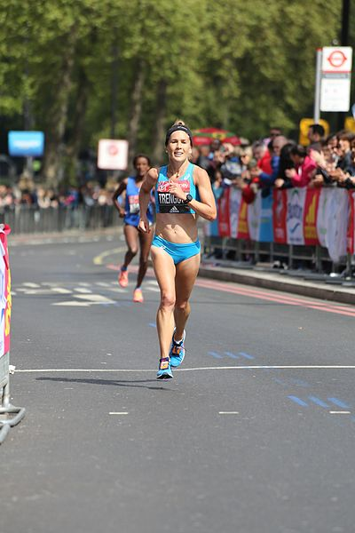
FITNESS COMPONENTS
Fitness, Health & Wellness
Being physically fit is only one dimension of health
Fitness is difficult to define as it means different things to different people in different contexts
A widely accepted definition of fitness
is ‘the ability to perform moderate to
vigorous levels of physical activity
without undue fatigue, & the capability
of maintaining such ability throughout life’
https://commons.wikimedia.org/wiki/File:2017_London_Marathon_-_Jessica_Trengove.jpg
Home

Slide 9
FITNESS COMPONENTS
The Components of Fitness Model
Allows individual aspects of fitness to be measured & compared to norms
Different sports & physical activities have different fitness requirements
There are two types of fitness components:
Health-related Fitness Components
Skill-related Fitness Components
Heath related fitness components are closely associated with health and fitness and are more important to health than to sporting ability.
Skill-related fitness components are often referred to as athletic ability or performance components and are more important to improved performance in sport & physical activity.
Home

Slide 10
FITNESS COMPONENTS
Health-related Fitness Components
Skill-related Fitness Components
Cardiorespiratory Endurance
Power
Muscular Strength
Coordination
Muscular Endurance
Balance
Flexibility
Agility
Body Composition
Speed
Reaction Time
Home

Slide 11
FITNESS COMPONENTS
Health-related Fitness Components
Cardiorespiratory Endurance
Heath-related Fitness Components
Closely associated with health and fitness and are more important to health than to sporting ability.
Muscular Strength
Muscular Endurance
Flexibility
Body Composition
Home

Slide 12
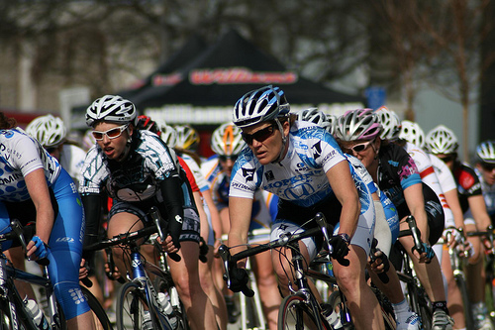
FITNESS COMPONENTS
Health-related Fitness Components
Cardiorespiratory Endurance
The ability of the cardiovascular (heart, lungs & blood vessels) & respiratory system to produce aerobic energy/ATP
Together these systems deliver O₂ & nutrients to muscles & remove by-products that have been produced by the body’s cells
Cardiorespiratory Endurance is also known as:
Aerobic Capacity
Aerobic fitness
Aerobic power
Endurance or capacity
Stamina
It’s related to the ability to
perform activities that
involve large muscle groups,
such as swimming, running
& cycling for extended periods of time.
Cardiorespiratory Endurance
Muscular Strength
Muscular Endurance
Flexibility
Body Composition
www.flickr.com/photos/bike/3340754054/
Home

Slide 13
FITNESS COMPONENTS
Health-related Fitness Components
Cardiorespiratory Endurance
Cardiorespiratory Endurance is dependent on the ability of the body to take in O₂, transport it & use it
Therefore the components of the cardiovascular & respiratory systems are important to aerobic power
Increased levels of Endurance are associated with:
An efficient & strong heart
Healthy blood vessels that are elastic & free from obstructions
Blood that has adequate levels of haemoglobin to carry the O₂
A fit respiratory system, including lungs & respiratory muscles
Muscle tissue that is capable of using the O₂
Cardiorespiratory Endurance
Muscular Strength
Muscular Endurance
Flexibility
A person’s maximum oxygen uptake (VO₂) is the usual measure of Cardiorespiratory Endurance
Body Composition
Home

Slide 14
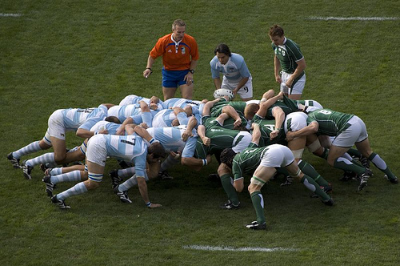
FITNESS COMPONENTS
Health-related Fitness Components
Muscular Strength
The maximal force that can be generated by a muscle or muscle group in one maximal effort (1 RM)
Muscular strength is important in sports where an object needs to be moved forcefully (such as in weight-lifting) or when the body needs to hold its position against the opposing force of the opposition
Cardiorespiratory Endurance
Muscular Strength
Muscular Endurance
Isometric contractions (no change in muscle length) produce maximum force, as seen in the rugby scrum. Once the scrum moves, it is no longer an isometric contraction
Flexibility
Body Composition
www.flickr.com/photos/vegaseddie/1471251541/
Home

Slide 15
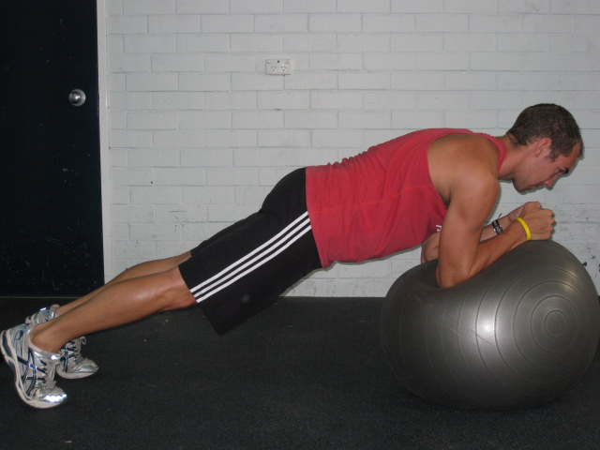
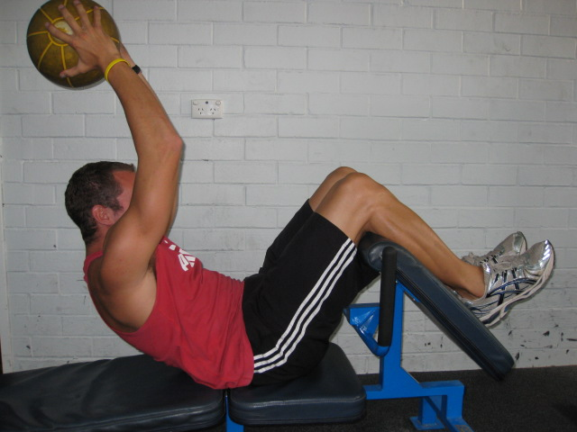
FITNESS COMPONENTS
Health-related Fitness Components
Muscular Endurance
The ability of the muscle or muscle group to perform repeated contractions (concentric, eccentric or isokinetic) for an extended period of time, or to maintain a contraction for an extended period of time (isometric contraction) in the face of fatigue.
Cardiorespiratory Endurance
Muscular Strength
Muscular Endurance
Flexibility
Body Composition
Home

Slide 16
FITNESS COMPONENTS
Health-related Fitness Components
Muscular Endurance
A muscle that has high levels of endurance must have reduced levels of fatigue; therefore muscular endurance can be also be thought of as the opposite of fatigue
The ability to sustain the contraction while fatigue increases is an important aspect of local muscular endurance
Cardiorespiratory Endurance
Muscular Strength
Muscular Endurance
Flexibility
Body Composition
Home

Slide 17
FITNESS COMPONENTS
Health-related Fitness Components
Flexibility
Flexibility is the range of motion (ROM) around a joint.
It serves the following functions:
Promotes healthy muscles and joints.
Improves elasticity of muscles and connective tissue around joints, which increases freedom of movement and creating potential for greater force production.
Makes day to day activities (turning, lifting, and bending) easier to perform
Helps prevent lower-back and other spinal column problems.
It is the capacity of a joint to move through its full range of motion, & reflects the ability of the muscle & connective tissue to stretch
Cardiorespiratory Endurance
Muscular Strength
Muscular Endurance
Flexibility
Body Composition
Home

Slide 18

FITNESS COMPONENTS
Health-related Fitness Components
Flexibility
There are two types of flexibility:
1. Static flexibility refers to a joints range of motion under stationary conditions
2. Dynamic flexibility refers to the resistance to motion in a joint. Someone with good dynamic flexibility will be able to move the joint through its full range of motion quickly & easily
Cardiorespiratory Endurance
Muscular Strength
Muscular Endurance
Flexibility
Body Composition
Home
www.flickr.com/photos/16462767@N00/3984507322/

Slide 19
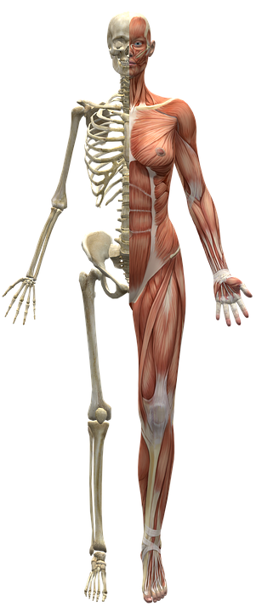
FITNESS COMPONENTS
Health-related Fitness Components
Body Composition
The term used to describe the different
components that, when taken together,
make up a person's body weight
Can be divided into two components:
Fat free mass: bones, water, muscle &
connective tissue, organs and teeth
2. Fat mass: essential & non essential
fat stores –
Essential fat - found in vital organs
& is required for normal physiological
functioning (control temperature,
shock absorption, regulation of nutrients)
Non essential fat - found in adipose tissue
Cardiorespiratory Endurance
Muscular Strength
Muscular Endurance
Flexibility
Body Composition
https://pixabay.com/en/muscles-skeleton-half-body-2277447/
Home

Slide 20
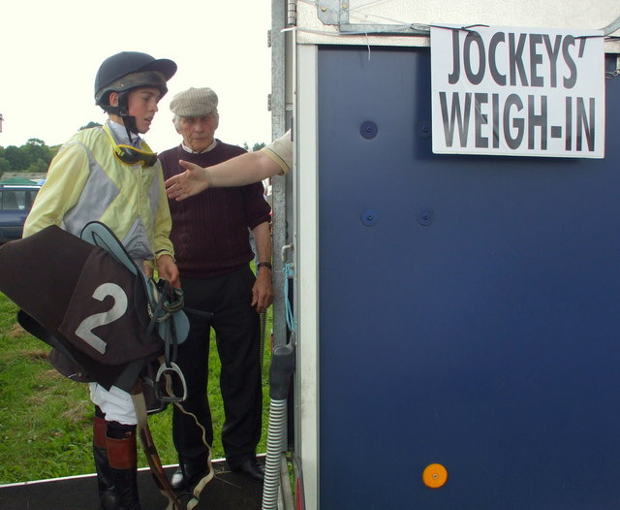
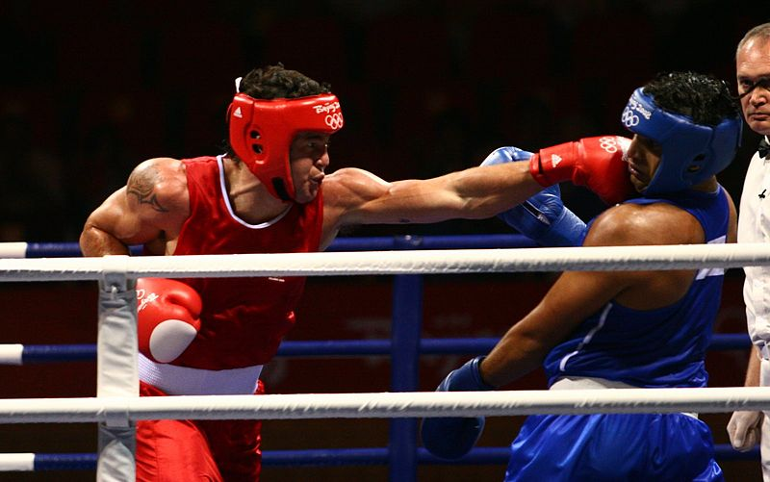
FITNESS COMPONENTS
Health-related Fitness Components
Body Composition
Important in many sports and activities, as well as for health
Healthy body-fat percentages are 16-25% for women and
< 20% for men
↑ levels of non-essential fat are detrimental to health and have been associated with ↑ risk of disease
Important in sports that have weight categories
Often athletes need to lose weight in a short period of time to make weight for their event. This sometimes involves dangerous practices that can compromise the athlete’s health.
Cardiorespiratory Endurance
Muscular Strength
Muscular Endurance
Flexibility
Body Composition
https://www.geograph.ie/photo/910987
https://en.wikipedia.org/wiki/File:Brad_Pitt_boxing.jpg
Home

Slide 21
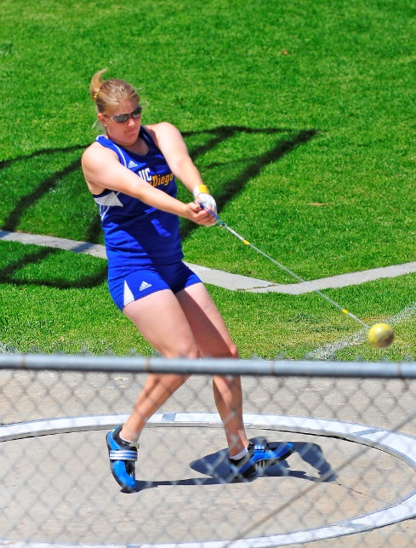
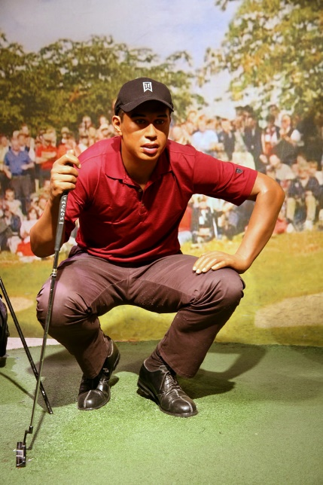
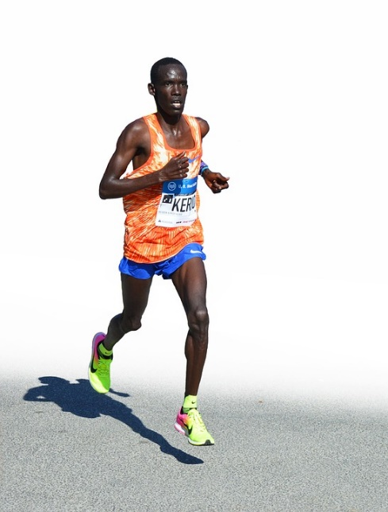
FITNESS COMPONENTS
Health-related Fitness Components
Body Composition
There is a lower limit of body mass at which point any further decrease in weight impairs health and alters normal physiological functioning of the body
Anthropometric measurements cannot provide precise estimates of percentage body fat, but can provide valuable & reliable information on increased health risk
Cardiorespiratory Endurance
Muscular Strength
Muscular Endurance
Flexibility
Body Composition
https://www.flickr.com/photos/dirkhansen/4618281617
https://www.flickr.com/photos/nostri-imago/3495161161
https://pixabay.com/en/marathon-runner-sport-compete-man-2834394/
Home

Slide 22
FITNESS COMPONENTS
Skill-related Fitness Components
Skill-Related Fitness Components
Often referred to as athletic ability or performance components are more important to improved performance in sport & physical activity.
These components are more important to improve performance in sport.
Performance in one area doesn't necessarily transfer to another. Might have a high level of skill in one area but not in another; however, it makes it easier to learn the skills that are needed for sport & physical activity.
Muscular Power
Coordination
Balance
Agility
Speed
Reaction Time
Home

Slide 23
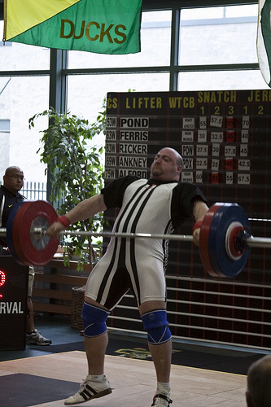
FITNESS COMPONENTS
Muscular Power
The ability to exert a maximal contraction quickly or in one explosive effort (often mixed up with strength)
Power = force * speed
Force = strength
Speed = speed at which movement occurs (distance/time)
Skill-related Fitness Components
Muscular Power
Coordination
Balance
Agility
Speed
Muscular Power = Strength x Speed
Reaction Time
Home
www.flickr.com/photos/jontunnell/3644800187/

Slide 24
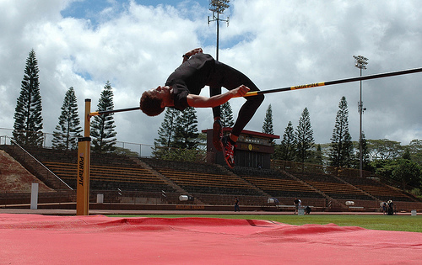
FITNESS COMPONENTS
Muscular Power
Allows athletes to jump higher, hit a ball harder
E.g. jumping events in athletics & throwing events such as javelin, hammer throw, shot put & discuss
Team sports often require leaping, jumping & rebounding
Power activities = high intensity & short duration: Energy derived from ATP-CP System
Skill-related Fitness Components
Muscular Power
Coordination
Balance
Agility
Speed
Reaction Time
www.flickr.com/photos/soldiersmediacenter/2606873855/
Plyometrics is a form of training based on this principle.
Home

Slide 25
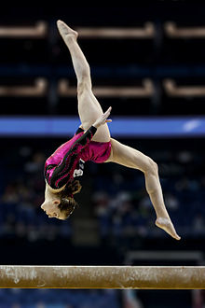
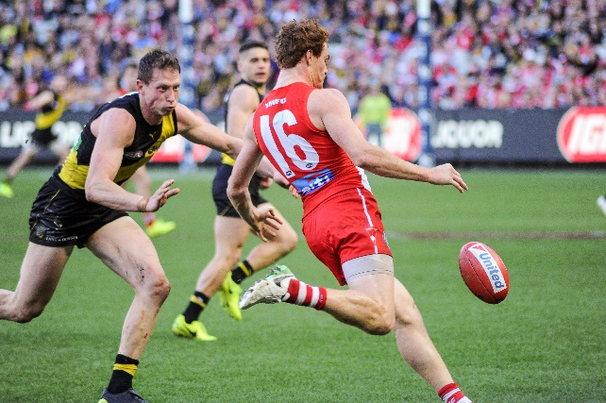
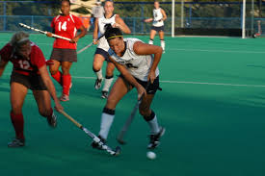
FITNESS COMPONENTS
Skill-related Fitness Components
Coordination
Refers to the skilful and effective interaction of movements.
It is the ability to use the body's senses to execute motor skills smoothly & accurately.
Coordination may involve the control of body parts (e.g. gymnastics routine) or it may involve the control of an external implement & various body parts (e.g. hockey stick).
Coordination is often referred to as hand-eye, head-eye or foot-eye coordination. This refers to the body parts involved in the motor skill.
Muscular Power
Coordination
Balance
Agility
Speed
Reaction Time
https://en.wikipedia.org/wiki/Somersault
https://upload.wikimedia.org/wikipedia/commons/b/b7/Gary_Rohan_kicking.1.jpg
https://commons.wikimedia.org/wiki/File:Indiana_(57)_(5027504987).jpg
Home

Slide 26
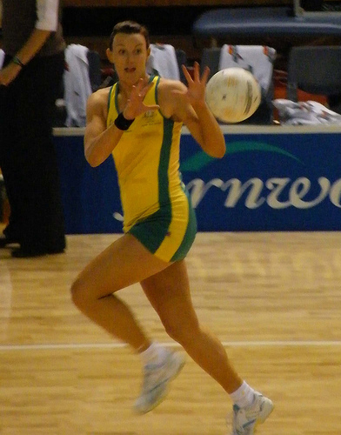
FITNESS COMPONENTS
Skill-related Fitness Components
Coordination
Elite athletes with excellent coordination are often characterised by smooth well-timed movements & execute the skill with less effort
Coordination improves with the learning of a skill
At first it feels awkward however
with practice learning occurs &
over time the movement will
become smooth & coordinated
Muscular Power
Coordination
Balance
Agility
Speed
An athlete needs to demonstrate balance, muscular contraction, movement and feedback in order to perform a well coordinated movement.
Reaction Time
www.flickr.com/photos/28990363@N05/2927027283/
Home

Slide 27
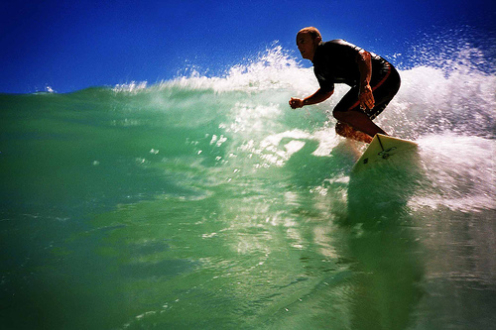
FITNESS COMPONENTS
Skill-related Fitness Components
Balance
Maintaining equilibrium while stationary or moving
Static equilibrium refers to activities where balance is maintained while the body is stationary.
Dynamic equilibrium refers to maintaining balance while moving. E.g. include cycling, gymnastics or surfing & these activities require more effort to maintain body balance.
Balance is specific to the task being
performed & the body continually
adjusts its position in order to
maintain balance in all situations.
Muscular Power
Coordination
Balance
Agility
Speed
Reaction Time
www.flickr.com/photos/danielflower/377500529/
Home

Slide 28
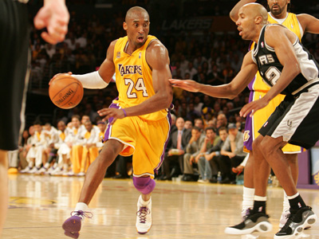
FITNESS COMPONENTS
Skill-related Fitness Components
Agility
The ability to change body position or direction quickly and accurately while maintaining balance
Relies on anaerobic power, speed, flexibility, dynamic balance and coordination
Muscular Power
Coordination
Balance
Agility
Speed
Reaction Time
www.flickr.com/photos/wdpg_share/3177157715/
Home

Slide 29
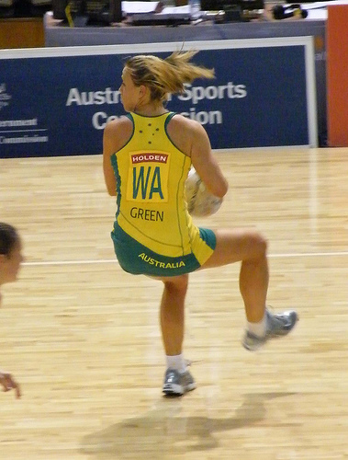

FITNESS COMPONENTS
Skill-related Fitness Components
Agility
Agility is of high importance in:
Evading an opponent in soccer or rugby
Reacting to an opponent fake in basketball or hockey
Dribbling the ball around an opponent in basketball or soccer
Changing direction in a dance, gymnastics or aerobics
Muscular Power
Coordination
Balance
Agility
Most sports not only require athletes to be able to run fast, but also change direction whilst maintaining speed and balance
Speed
Reaction Time
www.flickr.com/photos/28990363@N05/2927897740/
www.flickr.com/photos/curoninja/2760299988/
Home

Slide 30
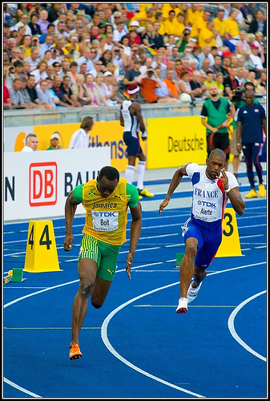
FITNESS COMPONENTS
Skill-related Fitness Components
Speed
The rate of motion (how fast you can move your body part from one point to another)
Speed = Distance x Time
Muscular Power
Coordination
Balance
Agility
An athletes maximum speed is seldom reached in team sports and as a result fitness testing in most sports measures athletes speed acceleration and speed endurance.
Speed
Reaction Time
www.flickr.com/photos/az1172/3841143960/
Home

Slide 31
FITNESS COMPONENTS
Skill-related Fitness Components
Speed
In sport, we refer to 3 different types of speed
Maximum speed
Usually occurs at the 40-50m mark (running).
Is of little relevance to most team sports – try and think of a team sport where you are required to sprint a distance of more than 50m regularly in one single effort.
Acceleration speed
Refers to the rate at which speed is increased.
Is of most relevance in team sports – this is why at talent ID programmes and top level draft camps, sprints testing takes place over a distance of only 20m
Muscular Power
Coordination
Balance
Agility
Speed
Reaction Time
Home

Slide 32

FITNESS COMPONENTS
Skill-related Fitness Components
Speed
Speed endurance
Refers to the ability of an athlete to either maintain maximal speeds or perform repeated maximal efforts whilst withstanding fatigue
This is of particular importance in team sports where athletes are often required to make repeat efforts
E.g. Full forward in AFL repeatedly leading to take a mark, 200m sprinter.
Muscular Power
Coordination
Balance
Agility
Speed
Reaction Time
Home
www.flickr.com/photos/az1172/3841143960/

Slide 33
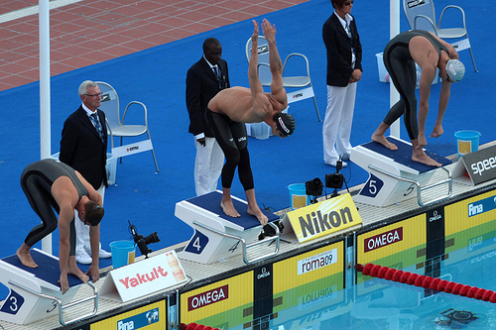
FITNESS COMPONENTS
Skill-related Fitness Components
Reaction Time
The time from the presentation of a stimulus to the onset of a response
Important in events where the environment is constantly changing & adjustments to movement need to be made quickly
Performers need to sort through the information presented to them via stimuli from the environment & select the most relevant cue
Muscular Power
Coordination
Balance
Agility
Speed
Athletes reaction time in sports such as swimming is critical as a matter of milliseconds often separates the field.
Reaction Time
www.flickr.com/photos/thewolf/3816967773/
Home

Slide 34
FITNESS COMPONENTS
Skill-related Fitness Components
Response time - the time taken from the presentation of a stimulus to the completion of the movement
Reaction time - the time between the presentation of a stimulus and the initiation of the response. It is the time the information processing system takes to interpret the situation, formulate a motor program and transmit the information to the Muscular System.
Movement time - the time taken from the initiation of the movement to the completion of the movement. It is the time the performer takes to physically complete the movement when the muscular system has received the message from the brain via the effector system.
Muscular Power
Coordination
Balance
Agility
Speed
Reaction Time
Home

Slide 35
TRAINING PRINCIPLES
Principles of training
specificity in relation to the nature of activity, positions and roles
intensity
duration
frequency
progressive overload
reversibility
School Curriculum and Standards Authority. Physical Education Studies ATAR Year 11 Syllabus, 2016.
Home

Slide 36
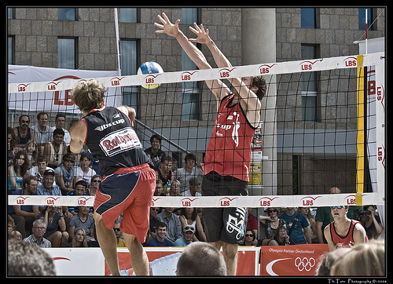
TRAINING PRINCIPLES
SPECIFICITY:
Relevant to the energy system, position-specific movements and fitness requirements of an activity­
This information is gathered through a games analysis to understand the specific demands of the sport
Athletes get what they train for – swimming training does not improve cricket skills
To ensure the principle of specificity is applied, we have coaches specific to playing positions to ensure a professional athletes training is tailored towards the individual demands of the position.
www.flickr.com/photos/def110/2730064850/
Home

Slide 37
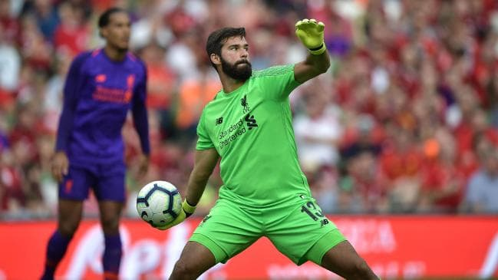
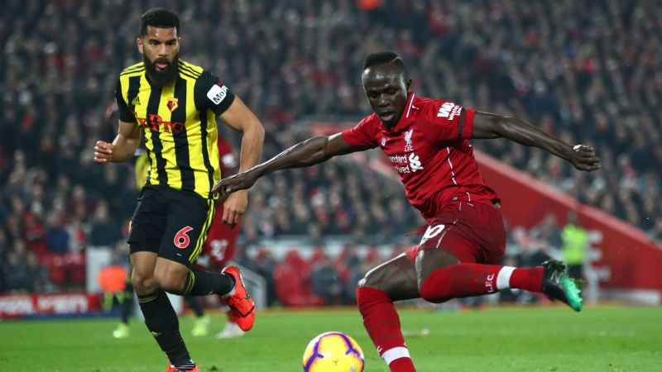
TRAINING PRINCIPLES
SPECIFICITY:
Energy Systems
Energy System usage should be identified for the sport & for each individual position. This enables the appropriate training method to be selected.
Aerobic – continuous, fartlek or long interval training
Anaerobic – short interval, medium interval, HIIT, plyometrics training & careful consideration of duration & work to rest ratio
Fitness Components
Fitness Components that dominate the activity need to be identified, as do fitness components that dominate for an individual in a team environment.
vs
Home
https://www.sportskeeda.com/football/number-nine-is-fine-for-liverpool-star-mane
https://www.sportskeeda.com/football/number-nine-is-fine-for-liverpool-star-mane

Slide 38
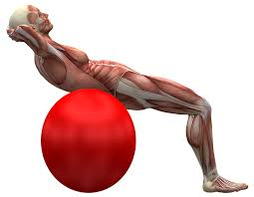
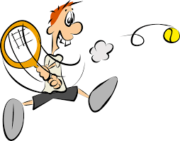
TRAINING PRINCIPLES
SPECIFICITY:
Major Muscles
Need to be identified to ensure they are focused
on in training
Balanced training of muscle groups also needs to
be maintained, with the coordinated development of
synergists & stabilisers
The muscles involved in core stability should also be
included in any training program
Common Skills
The common skills of an activity need to be identified
Its becoming more popular in training sessions to
blend skills sessions with physiological training in
an attempt to more closely replicate the activity
while developing the fitness components.
https://pixabay.com/en/photos/muscle/?image_type=illustration
https://www.maxpixel.net/Comic-Tennis-Cartoon-Comic-Character-Sports-1298769
Home

Slide 39
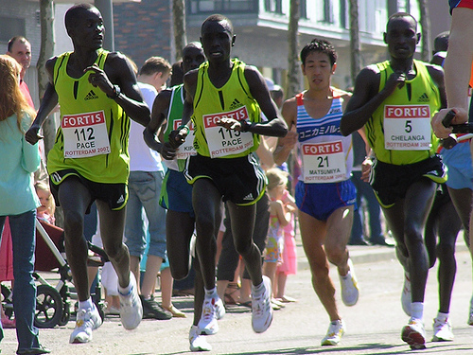
TRAINING PRINCIPLES
PROGRESSIVE OVERLOAD:
Overload: the planned, gradual increase in training load to ensure that fitness continues to be optimised
Applied once adaptation has occurred to a certain stimulus
Ensures that the training program produces chronic adaptations in the body and performance improvements
If overload is not applied, we see a plateau in performance
Overload must be progressive with only 1 variable or a 10% increase made in a training session to avoid injury and overtraining.
www.flickr.com/photos/jaccodotorg/459853057/
What training principles can be manipulated to ensure overload is applied? Increase frequency, duration, intensity, distance, sets, repetitions etc.
Home

Slide 40


TRAINING PRINCIPLES
APPLYING OVERLOAD TO TRAINING PROGRAMS:
Overload can be applied by:
Increasing the number of repetitions
Increasing the number of sets
Increasing the distance
Increasing the intensity within the set zone
Increasing the duration of work
Decreasing the amount of rest
Note that increasing the duration of work may change the dominant energy system, & decreasing the rest will change the work-to-rest ratio
Both may have an impact on the intended aim of the training program
For example, if the work-to-rest ratio is changed from 1:6 to 1:3,
the emphasis has shifted from the ATP–CP system to the Anaerobic
Glycolysis system
https://commons.wikimedia.org/wiki/File:Man_on_a_Treadmill_Cartoon.svg
Home

Slide 41
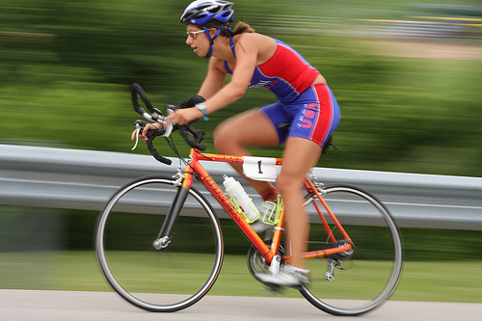
TRAINING PRINCIPLES
FREQUENCY:
The number of times training occurs in a given period
Aerobic training for beginners requires 3 sessions per week to improve
Endurance athletes may train 5-6 x per week due to the submaximal nature of training
Anaerobic training (strength, muscular power, plyometrics etc.) takes place 3 - 5 x per week. Due to the increased intensity, greater recovery time is required between sessions
By varying training methods and including recovery sessions, elite athletes can train 7 days a week & more than once a day
Home
www.flickr.com/photos/indywriter/2651954763/

Slide 42

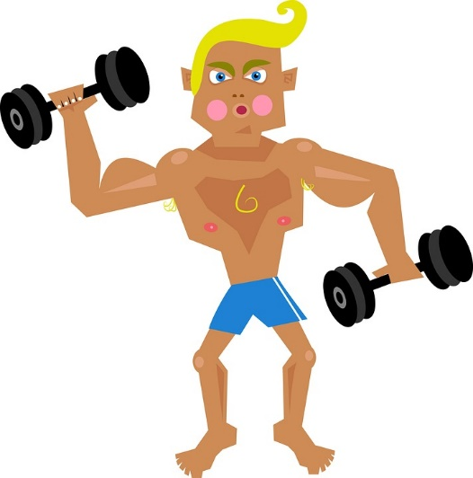
TRAINING PRINCIPLES
FREQUENCY:
Training to improve a fitness component must occur at least three times per week (however, this relies on the other core principles of training also being met).
Within the principle of frequency, rest & recovery are important considerations that also need to be built into the training program.
Training induces a catabolic (destructive) effect followed by an anabolic (constructive) effect during the recovery period. It is during the recovery periods between training sessions that many physiological adaptations to training occur.
https://commons.wikimedia.org/wiki/File:Apple_Calendar_Icon.png
https://pixabay.com/en/man-male-people-person-fitness-1082889/
Home

Slide 43
TRAINING PRINCIPLES
INTENSITY:
The magnitude of exertion required
Measured using following:
Heart-Rate (%HR max)
Oxygen uptake (%VO₂ max)
Lactate concentration
Maximal speed
Rating of perceived exertion charts (RPE)
TRAINING ZONE
85-100% max HR | Anaerobic training zone
65-85% max HR | Aerobic training zone
50-65% max HR | Low intensity Aerobic zone
>50% max HR | Recovery zone
www.flickr.com/photos/az1172/3841143960/
Aerobic adaptations require an aerobic training zone (between 65-85% max HR or RPE 3-6)
Anaerobic adaptations requires an intensity greater than 85% max HR or RPE 8
Home

Slide 44
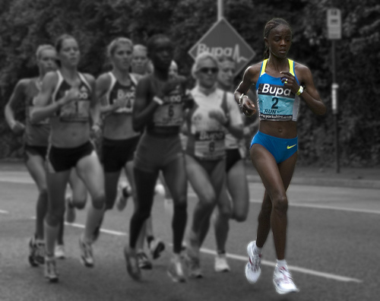
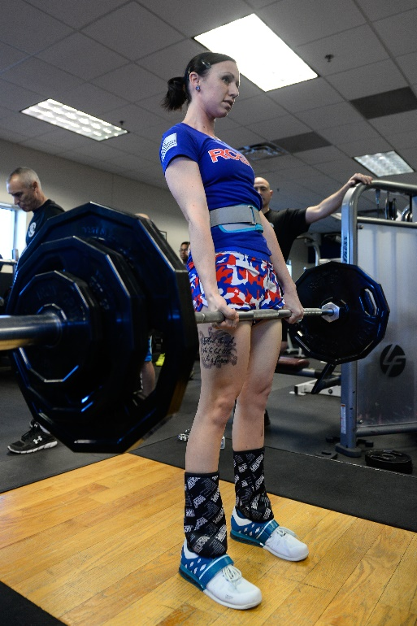
TRAINING PRINCIPLES
DURATION:
The length of training time
This can include time spent during:
Each session (minutes)
Total program (weeks or months)
20 minutes duration is required to make aerobic gains in a continuous activity
Gains in aerobic fitness take longer (12-16 weeks) than gains in anaerobic fitness/strength & power (8-10 weeks).
www.flickr.com/photos/sheffield_tiger/2843137983/
Home
44
https://www.schriever.af.mil/News/Article-Display/Article/734962/ocampo-regains-weightlifting-title/

Slide 45
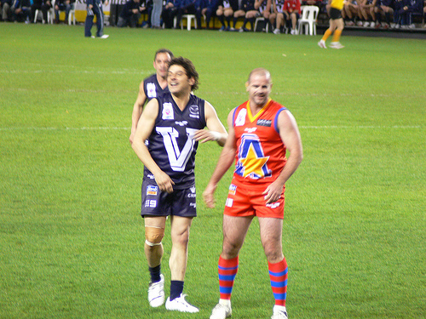
TRAINING PRINCIPLES
REVERSIBILITY:
The loss of physiological performance (detraining) occurs as a result of a person terminating or scaling back a regular training program
This usually starts in the first 1-2 weeks and increases the longer the athlete remains out of training
As a result, athletes employ various cross training activities during the ‘off season’ phase to avoid a severe detraining effect.
Cross training also allows athletes to rest various muscle groups used during the season whilst still retaining their aerobic base.
Home
45
www.flickr.com/photos/flying_cloud/3677350587/

Slide 46
TRAINING METHODS
Definition of training types
resistance training – isometric, isotonic, isokinetic
interval training
continuous training
circuit training
fartlek
flexibility
plyometrics
School Curriculum and Standards Authority. Physical Education Studies ATAR Year 11 Syllabus, 2016.
The goal of any training program is to develop the sporting potential of a performer, from a physiological perspective.
Home

Slide 47
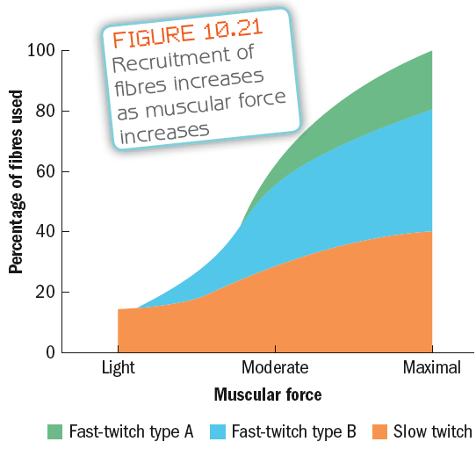
TRAINING METHODS
RESISTANCE TRAINING:
Resistance Training aims to build
muscle strength, muscle power
or local muscular endurance by
exercising muscles or muscle
groups against a resistance
Muscle fibres are recruited
according to intensity levels
Slow-twitch fibres are recruited at
lower intensities
As intensity increases, fast-twitch
fibres are recruited
Recruitment of fibres increase as muscular force increases
% of fibres used
Light
Moderate
Maximal
Muscular Force
Home

Slide 48

TRAINING METHODS
RESISTANCE TRAINING:
Benefits of Resistance Training:
Increases strength - allows an increase in force production which can be adapted for improvements in both power and speed
Promotes weight loss & balance - improves body composition
Helps prevent osteoporosis
Improves psychological wellbeing
Improves dynamic stability & preserves
functional capacity
Forms the foundation for the development
of speed, power & agility
https://pixabay.com/en/silhouette-body-building-3276824/
Home

Slide 49
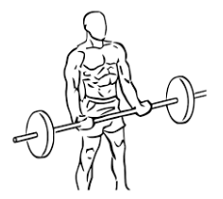
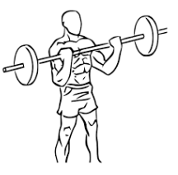
TRAINING METHODS
RESISTANCE TRAINING:
Isotonic weight training
Muscle changes length working against a constant load e.g. bicep curl, bench press etc.
Isotonic contractions can be divided into 2 types of muscular contraction;
Concentric contraction – muscle shortens during contraction e.g. raising phase of bicep curl (diagram 1)
Eccentric contraction – muscle lengthens during contraction e.g. lowering phase of bicep curl (diagram 2)
1
2
https://commons.wikimedia.org/wiki/File:Bicep_curls_with_barbell_1.svg
https://commons.wikimedia.org/wiki/File:Bicep_curls_with_barbell_2.svg
https://commons.wikimedia.org/wiki/File:Bicep_curls_with_barbell_2.svg
https://commons.wikimedia.org/wiki/File:Bicep_curls_with_barbell_1.svg
Home

Slide 50

TRAINING METHODS
RESISTANCE TRAINING:
Isometric resistance training
Type of strength training where the joint angle and muscle length do not change during contraction.
This can be completed using the body's own structure – e.g. holding a plank, bridge, crouched position or by using weights – e.g. holding a bench press in a fixed position
Home
https://www.flickr.com/photos/mikecogh/25785051891

Slide 51
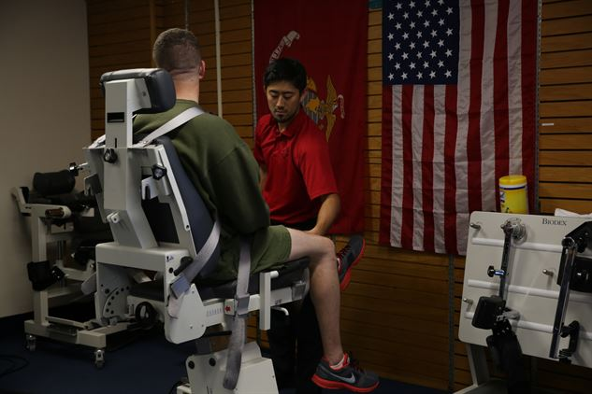
TRAINING METHODS
RESISTANCE TRAINING:
Isokinetic resistance training
An isokinetic force results in a change in muscle length against a varying load so that the resistance changes throughout the muscle’s range of movement.
Cannot be done using free weights but requires expensive specialised equipment to ensure the speed of muscular contraction remains constant.
Home
https://www.gceitf.marines.mil/News/News-Article-Display/Article/833551/integrated-task-force-supported-by-researchers-corpsmen/

Slide 52

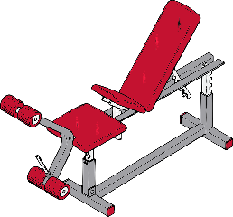
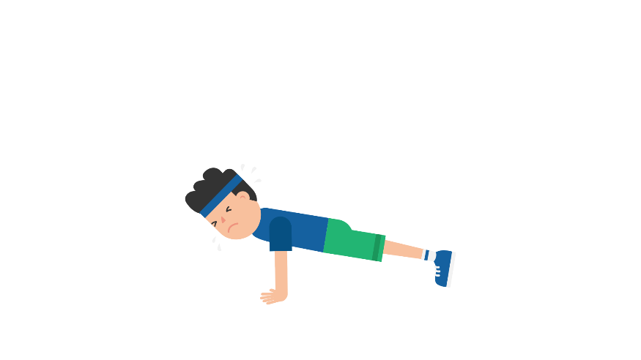
TRAINING METHODS
RESISTANCE TRAINING
Weight Training Terminology
Term | Meaning | Term | Meaning
Repetitions (reps) | The number of times a weight will be lifted in a sequence | Multi-joint | Where two or more joints are involved, such as a squat
Load | The amount of weight to be lifted | Single joint | Where only one joint is involved, such as a bicep curl and the elbow joint
Sets | A group of repetitions performed without a rest | Free Weights
1RM | The maximum weight that can be lifted in one maximal exertion | Machine
Speed of contraction | The speed at which the weight is lifted | Own body resistance
Home

Slide 53

TRAINING METHODS
RESISTANCE TRAINING
Manipulation of repetitions, sets, %1RM and recovery between sets determines type of weights training:
Local Muscular Endurance
Hypertrophy
Strength
Power
https://pixabay.com/en/sport-weight-lifting-weight-3735288/
 | Speed of contraction | %1RM | Volume (sets x reps) | Recovery
Endurance | medium | 40-50% | 2-3 x 15-30 | 30sec-1min
Hypertrophy | slow | 65-75% | 4-6 x 12-15 | 30sec-1min
Strength | slow | 70-100% | 3-5 x 1-10 | 2-3min
Power | fast | 30-60% | 2-3 x 10-12 | 2-3min
Home

Slide 54


TRAINING METHODS
INTERVAL TRAINING:
Series of repeated bouts of exercise interrupted by pre - determined rest periods or lighter exercise
Depending on the length of the work & rest periods, interval training can be used to develop any of the three energy systems
Benefits of Interval Training:
Higher intensities can be maintained for the
work phase of the program, enhancing the
quality of the session
Pacing can be developed
Specific energy systems can be targeted
Lactate tolerance (medium-interval), which
is crucial in many sporting pursuits, can be
developed
Interval sessions can be specific to the game,
with similar work-to-rest ratios
Sessions are highly structured, which enables
progress to be measured
https://commons.wikimedia.org/wiki/File:Dtjohnnymonkey-Stopwatch-no-shading.svg
https://pxhere.com/en/photo/1459191
Interval training can be further classified into long, intermediate, short, or high-intensity interval training
Home

Slide 55
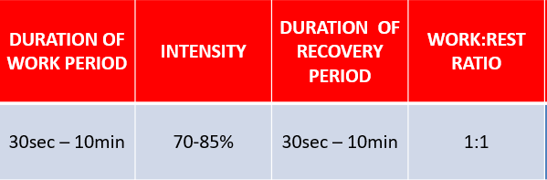
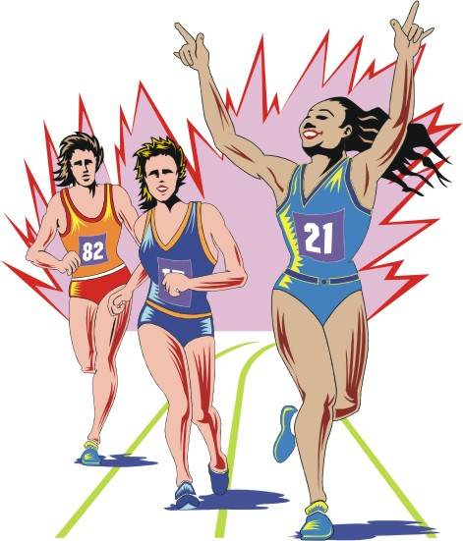
TRAINING METHODS
LONG INTERVAL TRAINING:
Long Interval Training is where the work period is dominated by the Aerobic energy system
This occurs when the work period is 1 minute or longer, or the work-to-rest ratio is 1:1 or greater (2:1, 3:1 etc.)
For example:
The aim of long-interval training is to increase the
performer’s lactate threshold (LT)
Beneficial in developing pacing (pace required to
achieve a certain time in an aerobic dominated event)
https://www.offutt.af.mil/News/Commentaries/Display/Article/312677/a-marathon-to-remember/
Home

Slide 56
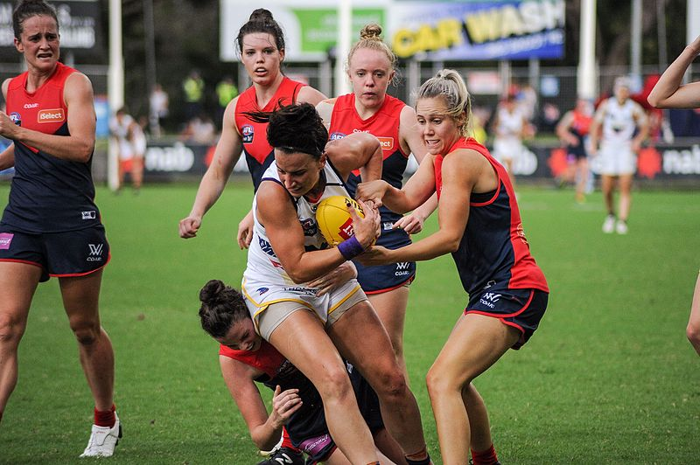
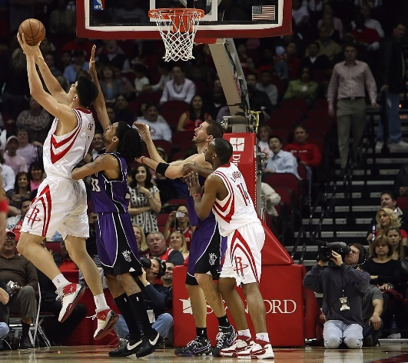
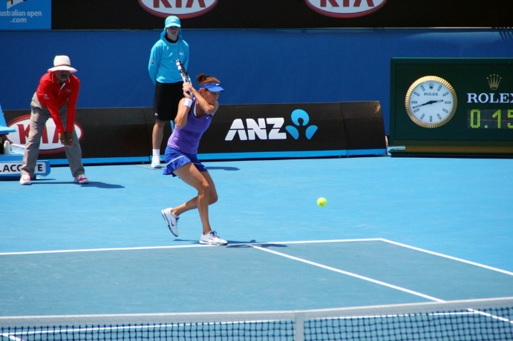
TRAINING METHODS
INTERMEDIATE INTERVAL TRAINING:
Intermediate Interval (or Medium Interval) Training is where the work period is dominated by the Anaerobic Glycolysis system
This occurs either when the work period is between 10 & 60 seconds or when the work-to-rest ratio is 1:2 or 1:3
The aim is to develop tolerance of lactic acid
This is particularly important for team sports that regularly require performers to maintain high intensity output in the presence of metabolic by-products
https://commons.wikimedia.org/wiki/File:Sedunary_breaking_tackle.jpg
https://pxhere.com/en/photo/563640
https://picryl.com/media/julia-gorges-australian-open-2012-tennis-2e0fce
Home

Slide 57

TRAINING METHODS
SHORT INTERVAL TRAINING:
Short Interval Training is where the work period is
dominated by the ATP–CP energy system
The rest component cannot be reduced below
1:6 as this would change the emphasis of the
energy system being trained
The aim of short-interval training is to improve speed
and increase the amount of PC stores to enable the performer to work at their highest intensity for longer
4 x 50 m
6 x 20 m
8 x 10 m
6 x 20 m
4 x 20 m
Completed at 95% effort
Work : Rest = 1:6
TYPE | DURATION OF WORK PERIOD | INTENSITY | DURATION OF RECOVERY PERIOD | WORK:REST RATIO
Short | 3-30sec | 85-100% | 20sec – 3min | 1:6
Home

Slide 58

TRAINING METHODS
HIGH INTENSITY INTERVAL TRAINING (HIIT):
High Intensity Interval Training (HIIT) is a relatively new aerobic training concept involving periods of short, high-intensity work followed by periods of lower intensity recovery
Shorter in duration than many of the more
traditional aerobic training methods
Offers an effective training alternative
to people with limited time
A thorough warm-up is crucial before
commencing the main phase of the session
No set formula to HIIT Training:
Session 1:
30 secs of max effort (RPE 9 or 10)
4 minutes rest
Repeat 4 – 6 times
Session 2:
Low speed for 30 secs
Moderate speed for 20 secs
High speed for 10 secs
Repeat 5 times continuously followed by 2 mins recovery
Repeat for 3 – 4 sets
2 different examples are presented here
Home

Slide 59
TRAINING METHODS
CONTINUOUS TRAINING (Long Slow distance training or Low Intensity Steady State)
Continuous Training involves performing an activity, such as jogging, cycling or swimming, nonstop for a period of time
Used to improve aerobic fitness and local muscular endurance
To maximise the benefits of continuous training, a heart rate range of
70- 85% max HR should be maintained for a minimum of 20 minutes
This is known as the Aerobic Training Zone
Involves sustained
activity for period of over
20min
Continuous training should occur 3 – 4 times a week & include whole body activities which use large, major muscle groups
Home
www.flickr.com/photos/sheffield_tiger/2843137983/

Slide 60
TRAINING METHODS
CONTINUOUS TRAINING – Lactate Threshold Training
Lactate threshold training can be continuous in nature and requires an exercise intensity at or slightly above the lactate threshold.
Research suggests training at or close to ones lactate threshold increases the intensity at which it occurs
Whilst it is difficult to measure ones exact lactate threshold outside of a laboratory, this usually occurs by exercising at a heart rate of approximately 85-90% max HR.
Home

Slide 61

TRAINING METHODS
CIRCUIT TRAINING:
Circuit Training comprises a sequenced performance of exercises at different activity stations (typically, between 8-12 stations) completed in a given time or by a pre - determined work:rest ratio
The completion of each exercise in the circuit once is known as a lap
(2 or 3 laps of exercises are usually performed in a circuit)
Can be tailored to suit the needs of an individual / develop specific components
of fitness / improve their overall fitness
Beneficial to improve multiple fitness components
(speed, muscular power, local muscular endurance, balance & agility)
Benefits of Circuit Training:
Offers variety
Several fitness components can be targeted
Specificity can be maintained
Can accommodate large groups of people
Minimal equipment is required
CIRCUIT
TRAINING:
https://www.publicdomainpictures.net/en/view-image.php?image=239468&picture=gym
Home

Slide 62

TRAINING METHODS
CIRCUIT TRAINING cont.
Fixed Time Circuit Training
The performer completes as many repetitions of the exercise in the allocated time
The time spent at each station can easily be varied, e.g. 30, 45 or 60 secs is usual & a 10 sec rest between each station
Fixed Loaded Circuit Training
The number of repetitions to be performed at each station is pre-determined
The performer moves from station to station, completing the designated sequence
Overloading Circuit Training
Multiple ways to overload, for example:
increasing the resistance (if using weights)
adding more stations
adding more laps to the circuit
increasing the time spent at each station
attempting to complete more repetitions
at a station (N/A to a fixed load circuit)
https://commons.wikimedia.org/wiki/File:Man_Doing_Push_Ups_Cartoon.svg
Home
https://commons.wikimedia.org/wiki/File:Man_Lifting_Barbell_Cartoon.svg

Slide 63
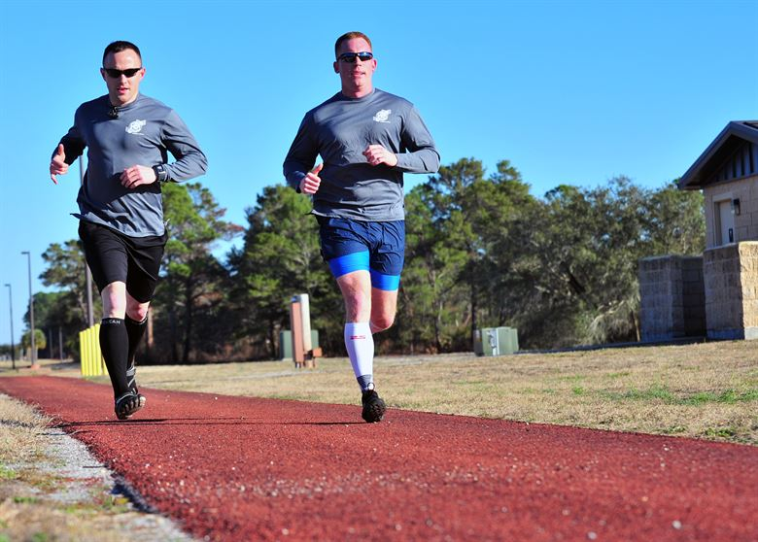
TRAINING METHODS
FARTLEK TRAINING:
Fartlek Training a variation of continuous training, involves changes of intensity throughout the training sessions.
These changes of intensity can be simply an increase in pace or running up a hill, & involve the addition of the anaerobic glycolysis energy system to help produce the increased amount of ATP needed for the increased intensity. As a result, it stimulates the interplay between the aerobic & anaerobic energy systems used in individual sports & in team games.
Fartlek is mainly used by runners,
but the concept is equally useful for
swimming, cycling, rowing & skiing
basically any sport where a
combination of aerobic & anaerobic
energy is important.
https://www.acc.af.mil/News/Article-Display/Article/661407/and-dollar-prints/
Fartlek Is different from interval training as work:rest ratios are not pre-determined and are more random in nature.
Home

Slide 64
TRAINING METHODS
FARTLEK TRAINING:
The advantage of Fartlek Training is that it improves both the aerobic and anaerobic energy systems & related fitness components (aerobic capacity, anaerobic capacity & speed)
However, because of the random nature of fartlek, it is extremely difficult to overload, & considerable discipline is require to repeatedly perform random bursts of speed
Start / Finish
Jog
Run
Sprint
Home

Slide 65

TRAINING METHODS
FLEXIBILITY TRAINING:
Improved flexibility will:
Improve sporting performance through enhancing developments in speed, strength & power
Reduce the likelihood of injury, particularly for performers who require a full range of motion in their sporting pursuits
Improve posture
Reduce the impact of DOMS
Release stress & tension
There are four major methods of flexibility (or stretching) training:
Static Stretching (performed without movement)
Dynamic Stretching (performed with movement)
Ballistic Stretching (performed with explosive movement)
Proprioceptive Neuromuscular Facilitation (PNF) stretching
https://www.maxpixel.net/Silhouette-Dancing-Ballet-Jumping-Fitness-Sports-3280313
Home

Slide 66
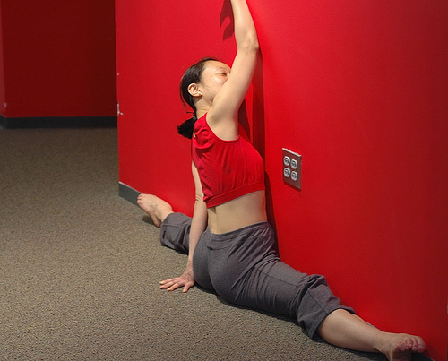
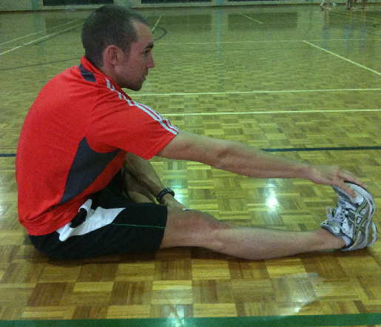
TRAINING METHODS
FLEXIBILITY TRAINING cont.
STATIC – performed without movement
DYNAMIC – performed with movement
BALLISTIC – performed with explosive movement
The following methods can be used to develop flexibility:
1. STATIC STRETCHING:
Muscle is held at its maximum range for a period of up to 30sec
Used to develop static flexibility
www.flickr.com/photos/listenmissy/141705357/
Home

Slide 67
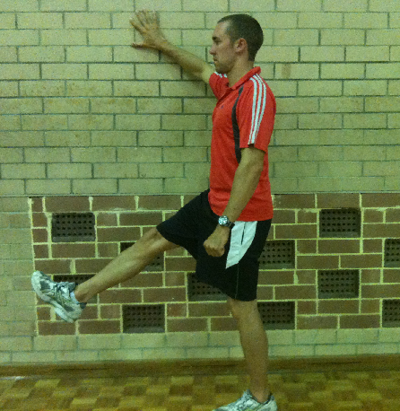
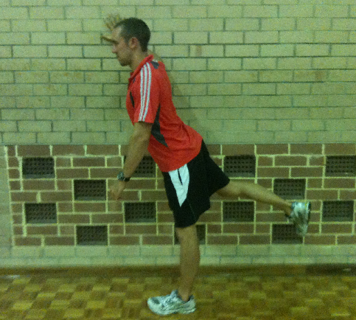
TRAINING METHODS
FLEXIBILITY TRAINING cont.
2. DYNAMIC STRETCHING
Muscle is moved through its range of motion (ROM) with controlled momentum, designed to emulate the expected movements you are about to perform
E.g. Before a game of AFL – player swinging their leg, simulating the movement of kicking
Most suited to warm up as it moves the muscles through the full ROM
NOTE: Before engaging in dynamic stretches, its critical you warm the muscles up with light aerobic exercise to avoid any injury.
Home
©PE STUDIES RESOURCES

Slide 68

TRAINING METHODS
FLEXIBILITY TRAINING cont.
3. BALLISTIC STRETCHING:
Involves using the momentum of a moving body or a limb in an attempt to force it beyond its normal range of motion
Involves bouncing into or out of a stretched position
Potentially dangerous, so only appropriate in limited circumstances (e.g. ballet dancer)
http://www.tango-space.com/body/3-types-stretching-one-tango-dancers-want-use/
Home

Slide 69



TRAINING METHODS
FLEXIBILITY TRAINING cont.
4. PROPRIOCEPTIVE NEUROMUSCULAR FACILITATION (PNF):
Advanced form of flexibility training involving the contraction and stretching of specific muscle groups
Should only be performed under the guidance of individuals as there is a risk of overstretching causing injury
STEP 1 - assume the position to stretch. Extend the body limb until the muscle is stretched and slight tension is felt.
STEP 2 - The athlete then contracts the stretched muscle for approx 5 - 8 sec whilst the partner inhibits all movement by providing resistance.
STEP 3 - The muscle group is relaxed, then immediately pushed past its normal ROM for approx 20-30 seconds.
Home

Slide 70

TRAINING METHODS
PLYOMETRICS TRAINING:
Plyometrics is a training method designed to produce fast, powerful movements, and to improve the functions of the nervous system.
The aim of plyometrics is to increase muscular power by first stretching a muscle & then contracting it in the shortest possible time
Involves rapid movements aimed at using the strength and elasticity of a muscle to jump higher, run faster, throw farther, or hit harder, depending on the demands of the sport you are training for
Plyometrics is as an effective training method to enhance power & improve both speed & agility
https://commons.wikimedia.org/wiki/File:USMC-05301.jpg
Home

Slide 71

TRAINING METHODS
PLYOMETRICS TRAINING cont.
Because of its explosive nature, care needs to be taken to minimise the risk of injury when introducing a plyometrics program
Consider the following guidelines:
A strength base is recommended before commencement of a plyometrics program
Appropriate footwear, warm-up and surface are paramount
Lower-intensity plyometrics exercises should be used initially, before progressing to harder exercises
Ample rest (at least one minute) is required
between sets
When performed concurrently with another
training method (such as short interval or
strength training), 2 sessions per week are
sufficient to elicit improvement / prevent injury
http://www.jbsa.mil/News/Photos/igphoto/2000909089/
Home

Slide 72
FITNESS COMPONENT | TRAINING METHOD
Aerobic Capacity | Continuous training Fartlek training Circuit training Long Interval training
Strength | Weights training Circuit training
Power | Weights training Plyometrics Circuit training
Local muscular endurance | Weights training Continuous training Circuit training
Speed | Plyometrics training Short Interval training Weights training
Agility | Interval training Circuit training
Flexibility | Static stretching Dynamic stretching PNF stretching

Slide 73

FUELS REQUIRED FOR RESYNTHESIS OF ATP
Utilisation of carbohydrates, fats and proteins as energy sources for physical activity, and their role in the onset of fatigue
School Curriculum and Standards Authority. Physical Education Studies ATAR Year 11 Syllabus, 2016.
http://www.netdoctor.co.uk/healthy-eating/advice/a26628/what-to-eat-post-exercise-based-on-workout/
Home

Slide 74



FUELS REQUIRED FOR RESYNTHESIS OF ATP
Consuming food provides the body with the energy required for the contraction of muscles
However, the energy contained in food cannot be used directly by the body, so instead it is used to form a chemical compound called ATP which is stored in the muscle fibre
https://pxhere.com/en/photo/1165715
https://upload.wikimedia.org/wikipedia/commons/2/2e/Fast_food_meal.jpg
Home

Slide 75
FUELS REQUIRED FOR RESYNTHESIS OF ATP
WHAT IS ATP?
A chemical compound called adenosine triphosphate (ATP) is responsible for producing energy for movement.
When ATP is broken down energy is released
ATP is an adenosine molecule with three phosphate molecules attached
When energy is required for muscular contraction, one of the phosphate molecules (P) breaks off, releasing energy
ATP = Energy
ATP
ADP + Pi
ADENOSINE
P
P
P
ADENOSINE
P
P
Pi
Energy released
The breaking of this phosphate bond releases energy for movement
Home

Slide 76
FUELS REQUIRED FOR RESYNTHESIS OF ATP
WHAT IS ATP?
Only a very small amount of ATP is stored within muscles, so ATP must continually be rebuilt / resynthesised so that energy can be provided for longer periods of time.
ATP can be rebuilt / resynthesised from the breakdown of phosphate creatine (PC) or from the breakdown of macronutrients (carbohydrates, proteins & fats) from our diet.
www.flickr.com/photos/soldiersmediacenter/2606873855/
Only a very small amount of ATP exists at the muscles – sufficient for a few maximal contractions lasting 2 – 3 seconds (e.g. powerful, explosive actions such as jumps or 5 to 10 metre sprints).
Home

Slide 77
FUELS REQUIRED FOR RESYNTHESIS OF ATP
FOOD FUELS V CHEMICAL FUELS
Energy from the breakdown of PC or the stored forms of CHO, fats and protein are used to re-join ADP & inorganic Phosphate (Pi) to resynthesise ATP.
CHEMICAL FUELS
ATP
FOOD FUELS
stored in muscle
Phosphate Creatine (PC)
Carbohydrates (CHO)
Glycogen & Glucose
Free Fatty Acids & Triglycerides
stored form in the body
Fats
Protein
Amino Acids
Home

Slide 78





FUELS REQUIRED FOR RESYNTHESIS OF ATP
Carbohydrates (CHO)
Broken down into glucose for blood transportation
Stored as glycogen in the muscles & liver
Carbohydrates (sugars & starches, in foods such as fruit, cereal, bread, pasta & vegetables) are the body’s preferred source of fuel, particularly during exercise
Glycogen
Glucose
Liver
Carbohydrates
Muscle
https://medlineplus.gov/ency/imagepages/19825.htm
https://pixabay.com/illustrations/man-muscles-fitness-studio-sixpack-3133301/
Home

Slide 79



FUELS REQUIRED FOR RESYNTHESIS OF ATP
GLYCEMIC INDEX (GI)
Ranking of carbohydrates based on their immediate effect on blood glucose (blood sugar) levels.
Measured on a scale of 1 – 100
LOW GI FOODS
Apples
Lentils
Kidney beans
Peanuts
Navy beans
Sausages
MODERATE GI FOODS
Corn
Peas
White pasta
Sweet potatoes
Oranges
Oatmeal
HIGH GI FOODS
Pure glucose which has a GI of 100
Honey
White bread
White rice
Gel shot
https://pixnio.com/flora-plants/seeds/lentils
https://pxhere.com/en/photo/807306
https://www.cranksports.com/products/eGel/comp/efs.asp
Home

Slide 80

FUELS REQUIRED FOR RESYNTHESIS OF ATP
HIGH GI FOODS
Break down quickly during digestion – therefore have immediate effect on increasing blood sugar levels
Best consumed during and immediately after the event
DURING EXERCISE
Rapid absorption and release of energy into bloodstream provides opportunity to top up glycogen stores, helping to delay the depletion of glycogen stores
IMMEDIATELY AFTER EXERCISE (within 30min)
Immediately after exercise muscles are most responsive to topping up fuel supplies, therefore high GI foods need to be consumed within 30 minutes of the activity finishing
Home
https://hi.wikipedia.org/wiki/%E0%A4%AE%E0%A5%88%E0%A4%B0%E0%A4%BE%E0%A4%A5%E0%A4%A8

Slide 81

FUELS REQUIRED FOR RESYNTHESIS OF ATP
LOW GI FOODS
Break down slowly during digestion resulting in a slow release of glucose into the blood stream
Best consumed as part of the pre-event meal and after the event to replenish supplies
PRE – EVENT MEAL (1 – 4hrs prior)
Slower release of glucose into bloodstream helps keeps blood glucose levels topped up prior to race
AFTER EXERCISE (1 – 24hrs post exercise)
Assists with repletion of muscle and liver glycogen stores in the 24hr post exercise
https://commons.wikimedia.org/wiki/File:Charlotte_Morel_Lausanne2012b.JPG
Home

Slide 82
FUELS REQUIRED FOR RESYNTHESIS OF ATP
Blood glucose concentration
HIGH GI
Rapid increase in blood sugar levels
Used as immediate fuel source
Fast release glucose over shorter period of time
LOW GI
Slow increase in blood sugar levels
Slow release glucose over extended period of time
0
1
2
Time after eating (hours)

Slide 83

FUELS REQUIRED FOR RESYNTHESIS OF ATP
REBOUND HYPOGLYCAEMIA
Athletes must be careful they don't consume high GI foods 30 – 120min prior to event as it may cause REBOUND HYPOGLYCAEMIA.
Immediately after eating CHO, there is a rise in blood sugar levels resulting in the hormone insulin being released into the blood and lowering blood sugar levels.
When an athlete consumes HIGH GI foods just prior to physical activity, we see a rapid rise in blood sugar levels causing an overshoot in insulin release.
This significantly reduces blood sugar levels which impairs CNS functioning during exercise causing a negative effect on performance!
Home
https://commons.wikimedia.org/wiki/File:141100_-_Athletics_track_Patricia_Flavel_finish_line_-_3b_-_2000_Sydney_race_photo.jpg

Slide 84

FUELS REQUIRED FOR RESYNTHESIS OF ATP
Carbohydrate loading
Nutritional intervention aimed at delaying the depletion of glycogen stores. It occurs when the athlete increases the amount of CHO consumed prior to competition with the aim being to store extra glycogen in the liver and muscles. There are 2 main methods to load.
3 day method
Consume approximately 7-8g/kg bodyweight of carbohydrates for 3 days leading up to competition (approx 700g stored in the muscle and liver)
Players can still exercise, however there is significant tapering occurring leading up to competition so as to not deplete glycogen stores.
3 day method is not suitable for sports which require athletes to perform every week – a 3 day taper leading to a match on Saturday would require a taper starting on Wednesday which is not ideal
Home
https://www.flickr.com/photos/indywriter/2651954763

Slide 85
FUELS REQUIRED FOR RESYNTHESIS OF ATP
Advantages
CHO loading avoids the depletion of glycogen stores by increasing muscle and liver glycogen levels
By sparing glycogen, it allows aerobic athletes to maintain a higher intensity for a longer period of time.
Disadvantages
Binding of H₂O to CHO molecules increases water absorption, causing an increase in weight
*NOTE*
During exercise, CHO stores become depleted, causing an increase in the use of fats for energy.
Fats have a higher oxygen cost than CHO, therefore the body must reduce exercise intensity!
Home

Slide 86
FUELS REQUIRED FOR RESYNTHESIS OF ATP
Glycogen Sparing
Glycogen Sparing is the ability of an athlete to spare glycogen supplies by using an alternative fuel source during physical activity.
This can be achieved via the following methods;
Training effect
Through an aerobic training programme, athletes are better able to break down fats for a given intensity, sparing glycogen for later in the event.
Caffeine consumption
By consuming caffeine before the event, it better enables the athlete to break down fats at the start of the event, sparing glycogen for later in the event.
Pre – event meal
By consuming a low GI meal 1-4hrs prior to the event, it increases blood glucose levels allowing for the sparing of glycogen for later in the event.
During the event meal
By consuming high GI foods during the event, it allows blood glucose levels to be constantly topped up, sparing the use of glycogen as a fuel source.
Home

Slide 87





FUELS REQUIRED FOR RESYNTHESIS OF ATP
Fats
Fats (in butter, margarine, cheese, oil, nuts and fatty meats) are broken down into either fatty acids (FFA), which are found in adipose tissue & the blood, or triglycerides which are stored in the muscle
They are the body’s main source of fuel at rest & during prolonged submaximal exercise
Triglycerides
Free Fatty Acids
Fats
Muscle
Blood
https://pixabay.com/illustrations/man-muscles-fitness-studio-sixpack-3133301/
https://medlineplus.gov/ency/imagepages/19825.htm
Home

Slide 88




FUELS REQUIRED FOR RESYNTHESIS OF ATP
Protein
Protein (found in meat, fish, poultry, legumes, eggs and grains) makes a negligible contribution to energy production during exercise (5 – 10% in ultra endurance events)
An essential nutrient in the diet; it is needed to:
Build connective tissue & muscle cells
Act as enzymes which speed up chemical reactions
Stored in the muscles & around the body
Used mainly for growth & repair (only used as a fuel in extreme circumstances)
Amino Acids
Peptides
Adipose
Tissue
Protein
Muscle
Home
https://pixabay.com/illustrations/man-muscles-fitness-studio-sixpack-3133301/

Slide 89

ENERGY FOR REST AND ACTIVITY
Relative contribution of fuels (CHO and Fats) at varying exercise intensities
The ‘crossover concept’ is a theoretical model that explains the balance of CHO and Fat usage during sustained exercise.
The crossover point is the intensity at which energy from CHO predominates over energy from fats, with further increases in intensity resulting in greater CHO use and decreased fat oxidation.
Low to moderate exercise intensity – trained individuals will delay the switch to CHO as they are better able to utilise fats as a fuel source, resulting in glycogen sparing.
Training
FAT (%)
CHO (%)
AEROBIC POWER (%)
Home

Slide 90

ENERGY FOR REST AND ACTIVITY
Hitting the wall
The fuel source used for ATP production is based on the duration and intensity of exercise:
Low intensity / rest – stored fats are the main fuel source
As intensity of exercise increase, the contribution of muscle glycogen increases to meet the more immediate demands for fuel.
There is enough glycogen stored in muscles to fuel up to 60 minutes depending on intensity (and also training and CHO loading). Athletes “hit the wall” when muscle glycogen runs out.
When muscle glycogen stores run out, the stored liver glycogen becomes the primary fuel source allowing exercise to continue but performance starts to diminish.
https://commons.wikimedia.org/wiki/File:ANA_IVANOVIC_(6710610913).jpg
Home

Slide 91

ENERGY FOR REST AND ACTIVITY
Depletion of liver glycogen affects the brain – decision making ability affected
Fats now become the primary fuel source and intensity of exercise is reduced as fats require more complex chemical reactions and greater amounts of oxygen
Depletion of fats results in protein being used as a fuel source
This is only likely to occur in ultra endurance events
https://en.wikipedia.org/wiki/Marathon
Home

Slide 92
NUTRITION FOR SPORT: TRAINING PHASE
An athlete needs to eat the right combination of food during the training phase to ensure they are providing the body with the correct nutrients and fuel sources for the upcoming competition
CONSIDERATIONS
What type of sport is the athlete preparing for?
Expected climatic / environmental conditions?
AEROBIC EVENTS
Require high amount of CHO
Combination of high GI / low GI
Adequate protein for repair of muscle fibres damaged at training and following exercise
Maintain adequate fluid intake
ANAEROBIC EVENTS
Power athlete needs more protein than endurance athlete.
Power athletes require high amount of CHO to provide fuel for training
Maintain adequate fluid intake
CLIMATIC CONDITIONS
If competing in hot conditions, increase fluid intake above normal requirements
Cold environments – particularly endurance events - may require increased fat to assist with insulation
Home

Slide 93
NUTRITION FOR SPORT: PRE EVENT MEAL 1-4 HOURS BEFORE EVENT
Main aim of the precompetition meal is to provide adequate carbohydrates and to ensure optimal hydration leading into the event
CONSIDERATIONS
Food preference – liquid meals, nutrition bars may be consumed.
Digestibility of foods – consume foods low in fat and fibre
ADVANTAGES
Increase glycogen levels leading to glycogen sparing
Ensure optimal hydration
Ensure gastro – intestinal tract feels comfortable during performance
Consumed 1 – 4 hours prior to competition
Consume low GI foods for slow release of glucose into bloodstream.
The body tends to use the foods most recently digested as energy source – this assists with glycogen sparing
Pasta, all bran cereal, apples, lentils
Consume approx 600-800ml fluid 1hr prior to event to assist with hydration
Consume 30-60 g of High GI CHO per hour, or 1g/kg of body mass every hour.
E.g. sports bars, jelly beans etc.
Consume approx 150-200ml fluid every 15min to prevent dehydration
Home

Slide 94
NUTRITION FOR SPORT – FIRST 30min AFTER EXERCISE
Immediately following exercise (first 30min after), muscles are most responsive to topping up glycogen stores
As a result an increase muscle glycogen storage occurs due to the consumption of high GI foods
The more depleted the stores of CHO, the faster the rate of recovery.
http://www.netdoctor.co.uk/healthy-eating/advice/a26628/what-to-eat-post-exercise-based-on-workout/
Home

Slide 95
NUTRITION FOR SPORT – NEXT 24hrs AFTER EXERCISE
It takes at least 24 hours for glycogen replenishment after heavy endurance work
The amount of CHO replenishment will be dependant upon the intensity and duration of exercise
Consuming low / medium GI foods for the next 24 hours completes the replenishment of glycogen stores
Protein is also important post exercise to ensure the muscles repair in time for the next bout of exercise
1g/kg of body mass of high GI CHO within 30 minutes of event
At least 7-10g/kg body mass of low to moderate GI CHO over the next 24 hours.
Protein consumption
Consume fluid which equates to 1.5* weight loss
Home

Slide 96
FUELS REQUIRED FOR RESYNTHESIS OF ATP
REVISION VIDEOS
https://www.youtube.com/watch?v=_15eUNiH0eA
https://www.youtube.com/watch?v=jqrVl4V5ttQ
https://www.youtube.com/watch?v=Sfek80OSDQk
http://www.netdoctor.co.uk/healthy-eating/advice/a26628/what-to-eat-post-exercise-based-on-workout/
Home

Slide 97
ENERGY SYSTEMS
Response of energy systems to physical activity
anaerobic – adenosine triphosphate-creatine phosphate (ATP-CP)
lactic acid
aerobic
Relationship between energy systems and types of physical activity
the energy system continuum
School Curriculum and Standards Authority. Physical Education Studies ATAR Year 11 Syllabus, 2016.
Home

Slide 98
FUELS REQUIRED FOR RESYNTHESIS OF ATP
WHAT IS ATP?
A chemical compound called adenosine triphosphate (ATP) is responsible for producing energy for movement.
When ATP is broken down energy is released
ATP is an adenosine molecule with three phosphate molecules attached
When energy is required for muscular contraction, one of the phosphate molecules (P) breaks off, releasing energy
ATP = Energy
ATP
ADP + Pi (inorganic)
ADENOSINE
P
P
P
ADENOSINE
P
P
Pi
Energy released
The breaking of this phosphate bond releases energy for movement
Home

Slide 99
FUELS REQUIRED FOR RESYNTHESIS OF ATP
FOOD
Energy is released during the breakdown of ATP in to Adenosine diphosphate (ADP) and the third phosphate – represents the immediate source of energy that can be used by muscle cells to perform work.
When the body is performing physical work it is converting chemical Energy (ATP) produced by chemical reactions into mechanical energy (muscular contraction)
Is digested into
PROTEINS CARBOHYDRATES FATS
Which are used to form a chemical compound
ATP (Adenosine Triphosphate)
Breaking of phosphate bonds gives energy
ATP → ADP + P
Energy released is used by muscles to do work
©PE STUDIES RESOURCES
99
Home

Slide 100
FUELS REQUIRED FOR RESYNTHESIS OF ATP
WHAT IS ATP?
Only a very small amount of ATP is stored within muscles, so ATP must continually be rebuilt / resynthesised so that energy can be provided for longer periods of time.
ATP can be rebuilt / resynthesised from the breakdown of phosphate creatine (PC) or from the breakdown of macronutrients (carbohydrates, proteins & fats) from our diet.
www.flickr.com/photos/soldiersmediacenter/2606873855/
Only a very small amount of ATP exists at the muscles – sufficient for a few maximal contractions lasting 2 – 3 seconds (e.g. powerful, explosive actions such as jumps or 5 to 10 metre sprints).
Home

Slide 101
ENERGY SYSTEMS
Energy systems
ANAEROBIC
(Without oxygen)
AEROBIC
(With oxygen)
2 Pathways
ATP-CP SYSTEM
ANAEROBIC GLYCOLYSYS
3 energy systems
AEROBIC SYSTEM
Home

Slide 102
ENERGY SYSTEMS
RATE of ATP production = how quickly ATP is resynthesised
YIELD = how much ATP is resynthesised
There is a trade-off between rate and yield - the energy system with a higher yield (more ATP) has a slower rate (ATP resynthesised slower).
Home

Slide 103

ATP–CP ENERGY SYSTEM
An immediate energy system that does not require oxygen.
Also known as the phosphagen system.
FUEL: Uses a combination of stored ATP + the stored creatine phosphate
INTENSITY: Maximum efforts >95% max HR
DURATION: Short duration (fuel depleted after 10 secs)
RATE OF RESYNTHESIS: Very fast
YIELD: Low
Usain Bolt cruises to victory during the 100m sprint, an event predominantly fuelled by the
ATP–CP system.
www.flickr.com/photos/philmcelhinney/1000892083/
Home

Slide 104
ATP–CP ENERGY SYSTEM
Alternate names | Phosphocreatine system (PC) Creatine Phosphate system (CP) Phosphagen system Anaerobic Alactic System
Fuel Source | Creatine Phosphate (CP)
Intensity of activity best suited to | High intensity > 95% max HR
Rate (speed) of ATP production | Very fast
Yield (amount of ATP per mole of fuel source) | Smallest (< 1 ATP)
By Products | ADP and inorganic phosphates (Pi)
Duration (total) | 0–10 seconds

Slide 105
ATP–CP ENERGY SYSTEM
Duration system is dominant | 1–5 seconds Peaks at 2–4 seconds
Type of recovery | Passive
Fatigue limiting factor | Depletion of Creatine Phosphate stores
Example | Athletics field events (discus, javelin, long jump) Sprinter
Disadvantages | Resynthesises very limited amount of ATP Limited stores of ATP and PC in muscles
Advantages | Resynthesises ATP explosively/immediately Doesn’t need long chemical reactions Used for high intensity activities

Slide 106

ANAEROBIC GLYCOLYSIS
Anaerobic Glycolysis relies on the breakdown of glycogen, in the absence of
oxygen, to produce energy.
Also known as the glycolytic / non-oxidative energy system.
FUEL: Carbohydrate
INTENSITY: 80 - 95% max HR
DURATION: Will take over as predominant system when ATP–CP system fatigues (PC stores depleted at around 5–10 seconds). Predominant 10–60 second events. Peak power is usually reached between 5–15 seconds.
RATE OF RESYNTHESIS: Fast
YIELD: Low-Medium – 2ATP
400m Run
https://commons.wikimedia.org/wiki/File:Mens_400m_semi_final_3_-_2012_Summer_Olympics.jpg
Home

Slide 107


ANAEROBIC GLYCOLYSIS
Used for sustained sprint or muscular endurance activities usually lasting between 45 – 60 seconds
400 m sprint
200 m swim
Repeated high intensity efforts during a continuous game
100m Butterfly
Repeated sprint efforts in a game of Hockey
https://en.wikipedia.org/wiki/Northwestern_Wildcats_field_hockey
www.flickr.com/photos/thewolf/3817797434/
https://pixabay.com/photos/field-hockey-player-girls-game-1537470/
Provides ATP for longer during submaximal activities (when PC is depleted) and thus provides a ‘stop gap’ until enough oxygen is transported to working muscles for the Aerobic system to become the major contributor.
Home

Slide 108

ANAEROBIC GLYCOLYSIS
Glycolysis
Takes place in the cytoplasm, where the enzymes required are present.
Does NOT require energy as a larger molecule is being broken down (catabolism).
‘Lysis’ means to destroy, so the term Glycolysis is to destroy or break down Glucose.
As it involves a number of complex reactions, it’s not as quick off the mark as the ATP–CP System, but produces twice as much ATP.
Because oxygen is not present, the glycogen is not totally broken down and a by-product called lactic acid (lactate + hydrogen ions) is formed.
Home

Slide 109
ANAEROBIC GLYCOLYSIS
Lactic Acid
Use of the anaerobic glycolysis system results in the production of lactic acid.
What happens when we accumulate lactic acid?
Lactate purely serves as an indicator that the body is no longer working aerobically. It also represents the accumulation of Hydrogen⁺ ions.
Although 80% of lactate diffuses from the muscles & is transported back to the liver for conversion to glucose or glycogen some hydrogen ions (H⁺) accumulate in muscle tissue.
An increase in lactate levels means pH levels are dropping (a pH level of 7 indicates neutral – less than 7 means your muscles are becoming acidic!) which decreases the activity of enzymes which break down glycogen.
Contracting muscles don’t like acid, so when pH levels drop, they stop working as a feedback mechanism to prevent injury. As a result, the Anaerobic glycolysis pathway is compromised and exercise intensity must be reduced
Home

Slide 110
ANAEROBIC GLYCOLYSIS
Fuel Source | Glycogen (Carbohydrates)
Intensity of activity best suited to | High intensity (> 85% max HR)
Rate (speed) of ATP produced | Fast
Yield (amount of ATP per mole of fuel source) | Small (2 – 3 ATP)
By Products | Lactic acid, H⁺ ions, ADP
Duration (total) | 10 – 75 seconds
Duration system is dominant | 5 – 60 seconds Becomes dominant provider from the time the ATP–CP system starts rapidly depleting (approx. 5 sec) to when the Aerobic system takes over as the dominant provider (approx. 30 – 60 sec depending on intensity) Peaks between 5 –15 sec

Slide 111
ANAEROBIC GLYCOLYSIS
Type of recovery | Active
Fatigue limiting factor | Accumulation of H⁺ ions. This causes muscles to become more acidic affecting muscular contractions.
Example | 400 m runner Series of high intensity repeat efforts in any team sport 100 m swim
Disadvantages | Produces H⁺ ions that cause fatigue in large amounts Slow recovery Only capable of producing small amounts of ATP
Advantages | Resynthesises ATP quickly allowing for high intensity efforts

Slide 112

AEROBIC SYSTEM
Aerobic glycolysis: The breakdown of glycogen in the presence of oxygen to produce energy, carbon dioxide, water and heat.
FUEL: Carbohydrate + Fat (depending on intensity, duration)
INTENSITY: During rest and at sub-maximal intensities < 80% HR max
DURATION: Gradual increase in contribution as O₂ becomes available. Predominant energy system after 30 – 60 secs (depending on intensity).
RATE OF RESYNTHESIS: Slow
YIELD: Very High (36 – 38 ATP)
The aerobic energy system will be the major energy contributor for events of more than 75 secs up to several hours in duration & are below 80% max HR e.g. marathon
www.flickr.com/photos/36665622@N00/253527065/
Home

Slide 113


AEROBIC SYSTEM
Once O₂ becomes available to the muscle cell a different chemical reaction known as Aerobic Glycolysis takes place.
The Aerobic system takes a while to get going because a number of processes need to occur:
Lungs work harder to bring in more O₂
Heart pumps harder to transport O₂ rich blood to the muscles
Arteries expand to increase blood flow
This system has the greatest capacity to produce ATP but is the slowest to do so (high yield but low rate)
Activated at the start of intense exercise and contributes significant amounts of ATP during high intensity activities lasting 1 – 2 minutes and continues to be the major contributor as the Anaerobic Glycolysis system decreases its contribution.
www.flickr.com/photos/66915552@N00/490631592/
www.flickr.com/photos/walkn/2431049781/
www.flickr.com/photos/indywriter/2651954763/
Home

Slide 114

AEROBIC SYSTEM
The fuel source used by the Aerobic system (carbohydrates and fats) depends on the intensity & duration of the activity
Carbohydrates for the first 90 mins then fats up till 4 hours
CHO are the preferred energy source during high intensity exercise as fats can produce more ATP than CHO but they require more oxygen to produce an equivalent amount of ATP
Athletes competing in the Tour De France rely heavily on their Aerobic energy system to supply ATP to their working muscles.
www.flickr.com/photos/bike/3287056320/
Home

Slide 115

AEROBIC SYSTEM
When using the Aerobic system predominately, any accumulated lactic acid has the opportunity to be oxidized (removed) or converted back into glycogen to be used again as an energy source.
Called Gluconeogenesis and involves using non-carbohydrate sources (such as lactate) to create glucose/glycogen in the liver. This can only occur when there is sufficient oxygen to do so.
Home

Slide 116

AEROBIC SYSTEM
Remember that Pyruvate can be shuttled off into one of two pathways depending on whether there is sufficient O₂
If the cell has adequate O₂ for aerobic metabolism, then Pyruvate (formed from glucose) is converted to Acetyl CoA & enters the citric acid cycle
In this reaction the by-products are:
CO₂
H₂O
Heat
Glycolysis
These are NOT fatiguing
https://commons.wikimedia.org/wiki/File:1016_Muscle_Metabolism.jpg
As long as you continue to provide your body with energy supplies, this energy system could last forever.
Stored glycogen in the muscles is broken down to glucose. When the glycogen in the muscles is depleted, glycogen in the liver is used.
Home

Slide 117
AEROBIC SYSTEM
Aerobic Lipolysis
(Lipids = Fats)
Fats can produce more ATP than CHO, but they require more O₂ to do so
As a result of the increased O₂ cost with the transition from CHO to fats as the main fuel source, less O₂ becomes available to the working muscles & the risk of working anaerobically increases
This possibly explains why athletes are forced to ‘slow down’ when fats are used
https://commons.wikimedia.org/wiki/File:1016_Muscle_Metabolism.jpg
Home

Slide 118

AEROBIC SYSTEM
FATIGUE / LIMITING FACTORS
TYPE OF RECOVERY
Fuel depletion:
Using fats when glycogen is depleted leads to fatigue as fats take longer to break down and require more O₂ than CHO, which means less O₂ is available for muscles
Active Recovery
E.g. slow walking / jogging included in cool-down process or on a ‘rest day’
Heat (elevated body temperature):
As core temperature ↑ sweat rates ↑ and blood is redistributed to the skin’s surface
Less blood, O₂ and fuels for working muscles, so aerobic exercise may become increasingly anaerobic
HR and Cardiac Output also ↑ to continue supplying O₂ to working muscles
Active Recovery
https://pixabay.com/en/sports-runner-health-fitness-1050966/
Home

Slide 119
AEROBIC SYSTEM
Fuel Source | CHO (Glycogen) – during moderate to high intensity Fats (FFA’s) – during low to moderate intensity Protein – during extreme situations such as ultra endurance events when CHO and Fats have run out
Intensity of activity best suited to | Resting & Submaximal intensity < 80% HR max
Rate (speed) of energy supply | Slow Fats slower to resynthesis ATP than CHO
Yield (amount of ATP per mole of fuel source) | Largest 36 – 38 ATP per mole of glucose Over 100 ATP per mole of fat
By Products | CO₂, H₂O & Heat
Duration (total) | >75 seconds

Slide 120
AEROBIC SYSTEM
Duration system is dominant | 75+ seconds
Type of recovery | Active
Fatigue limiting factor | Depletion of glycogen stores Elevated body temperature
Example | Endurance athletes (triathlete, marathon runner, Tour De France rider) Mid field player in AFL, soccer, hockey
Muscle Fibre Type | Type I fibres
Disadvantages | Resynthesises ATP slowly (particularly fats) Fats have a high oxygen cost resulting in reduced intensity
Advantages | Resynthesises large amounts of ATP & produces non-fatiguing by-products

Slide 121
ENERGY SYSTEMS
REVISION VIDEOS
https://www.youtube.com/watch?v=OtaBmyCNf6s&ab_channel=PEBuddy
https://www.youtube.com/watch?v=TBDSpOnzFAo&ab_channel=MikeTyler
https://www.youtube.com/watch?v=dWe8vtztW-4&ab_channel=WhatsUpDude
School Curriculum and Standards Authority. Physical Education Studies ATAR Year 11 Syllabus, 2016.
Home

Slide 122
ENERGY SYSTEM INTERPLAY
Response of energy systems to physical activity
anaerobic – adenosine triphosphate-creatine phosphate (ATP-CP)
lactic acid
aerobic
Relationship between energy systems and types of physical activity
the energy system continuum
School Curriculum and Standards Authority. Physical Education Studies ATAR Year 11 Syllabus, 2016.
Home

Slide 123
ENERGY SYSTEM INTERPLAY
Interplay of the three energy systems in relation to the intensity, duration and type of activity:
The fuel source used for ATP production is based on the DURATION and INTENSITY of exercise
For most sports & activities, there is interplay between energy systems
All energy systems contribute but there is a predominant system depending on the requirements of the specific activity / effort
www.flickr.com/photos/28990363@N05/2927897740/
www.flickr.com/photos/curoninja/2760299988/
Home

Slide 124

ENERGY SYSTEM INTERPLAY
Energy system interplay at rest
At rest, the energy required for the resynthesis of ATP is almost completely derived from the Aerobic energy system
Fats are responsible for contributing about 2/3 of the energy required
CHO are responsible for contributing about 1/3 of the energy required
https://pxhere.com/en/photo/1390909
Home

Slide 125

ENERGY SYSTEM INTERPLAY
Energy system interplay during exercise
At the commencement of exercise, all 3 energy systems start contributing to the production of ATP at the same time.
In the early stages of physical activity (0–5 sec), the ATP–CP system makes the most significant contribution as it is able to produce ATP at the fastest rate, however runs out shortly after
When this system begins to deplete (at about the 5–6 sec mark) the Anaerobic Glycolysis system begins to take over as the dominant provider of ATP. This system is also able to produce ATP quickly, however produces fatiguing by-products. It remains the dominant provider until about the 30 sec mark.
http://www.publicdomainfiles.com/show_file.php?id=13497942616081
Home

Slide 126

ENERGY SYSTEM INTERPLAY
Energy system interplay during exercise
From 30 sec onwards the Aerobic system starts to produce ATP at a rate which meets the bodies demands for ATP and therefore becomes the dominant provider of ATP
The Aerobic system remains the dominant provider for the remainder of the event unless exercise intensity increases, at which point the Anaerobic Glycolysis system increases in it’s contribution to the production of ATP
https://www.pexels.com/photo/two-woman-doing-exercise-1671217/
Home

Slide 127

ENERGY SYSTEM INTERPLAY
Energy System Interplay during exercise to exhaustion
AEROBIC SYSTEM
Main source of energy from 30sec + (point when oxygen supply has increased sufficiently to contribute ATP)
Unlimited capacity to work unless insufficient fuel supply (food)
ATP–CP SYSTEM
Main source of energy in first 10 sec
Peaks in output at approx. 5 sec
Fatigues quickly due to depletion ATP/PC
ANAEROBIC GLYCOLYSIS SYSTEM
Main source of energy from 10 – 30 sec
Peaks in output at approx. 20 sec
Fatigues due to build up of lactic acid
Provides energy for up to 2 min
Home

Slide 128




ENERGY SYSTEM INTERPLAY
Q. State which energy system is predominant for the following sporting activities and justify why using the terms DURATION and INTENSITY.
400m Run
Pole Vault
100m Hurdles
https://commons.wikimedia.org/wiki/File:Mens_400m_semi_final_3_-_2012_Summer_Olympics.jpg
https://commons.wikimedia.org/wiki/File:Pole_Vault_Sequence_3.jpg
https://pxhere.com/en/photo/748720
1500m Swim
Dive off the blocks
Game of Hockey
https://www.goodfreephotos.com/people/swimmer-racing-in-pool.jpg.php
https://commons.wikimedia.org/wiki/File:141100_-_Swimming_Jeff_Hardy_diving_start_-_3b_-_2000_Sydney_event_photo.jpg
https://en.wikipedia.org/wiki/Northwestern_Wildcats_field_hockey
Home

Slide 129
ENERGY SYSTEM INTERPLAY
400m Run
https://commons.wikimedia.org/wiki/File:Mens_400m_semi_final_3_-_2012_Summer_Olympics.jpg
ANSWER: Anaerobic Glycolysis as the duration of a 400 m sprint is approx. 45 – 60 seconds and is performed at a high intensity.
Home

Slide 130
ENERGY SYSTEM INTERPLAY
Pole Vault
https://commons.wikimedia.org/wiki/File:Pole_Vault_Sequence_3.jpg
ANSWER: ATP–CP System as it is performed at a very high intensity over a short duration (approx. 5 – 10 secs) and requires explosive power.
Home

Slide 131
ENERGY SYSTEM INTERPLAY
100m Hurdles
https://pxhere.com/en/photo/748720
ANSWER: ATP–CP System as it is performed at a very high intensity over a short duration (approx. 10 – 12 secs).
Home

Slide 132
ENERGY SYSTEM INTERPLAY
1500m Swim
https://www.goodfreephotos.com/people/swimmer-racing-in-pool.jpg.php
ANSWER: Aerobic System as it is performed at a sub-maximal intensity over a duration of approx. 15+ minutes
Home

Slide 133
ENERGY SYSTEM INTERPLAY
Dive off the blocks
https://commons.wikimedia.org/wiki/File:141100_-_Swimming_Jeff_Hardy_diving_start_-_3b_-_2000_Sydney_event_photo.jpg
ANSWER: ATP–CP System as it is performed at a very high intensity over a very short duration (approx. 1 – 2 secs) and requires explosive power.
Home

Slide 134

ENERGY SYSTEM INTERPLAY
Game of Hockey
https://en.wikipedia.org/wiki/Northwestern_Wildcats_field_hockey
ANSWER: Aerobic System is predominant overall as the match duration is approx. 60 minutes and much of the time is spent at a low intensity (e.g. walking, jogging or standing).
However, throughout the match there will be times when the energy system that is predominant / providing an increased contribution to ATP changes (e.g. ↑ contribution from Anaerobic Glycolysis during repeat sprint efforts up and down the field when transitioning from attack to defence).
Home

Slide 135
ENERGY SYSTEM INTERPLAY
Home

Slide 136

ENERGY SYSTEM INTERPLAY
Steady State Exercise
Oxygen consumption rises sharply during first minutes of exercise.
This consumption begins to plateau between 3-4 mins and will remain stable for the duration of exercise.
This means there is a balance between energy required by working muscles and ATP produced by the aerobic pathway.
This is referred to as Steady State “exercise”.
https://pxhere.com/en/photo/1390909
Home

Slide 137

ENERGY SYSTEM INTERPLAY
Oxygen Deficit
When exercise commences, O₂ consumption does not reach “steady state” plateau immediately.
Oxygen deficit is the state in which there is a discrepancy (shortfall) between oxygen supply and demand and the oxygen required to meet the energy requirements of the activity.
Energy used during O₂ deficit period is supplied through Anaerobic pathways
Endurance-trained athletes reach steady state more rapidly, with smaller oxygen deficit.
https://pxhere.com/en/photo/1390909
Home

Slide 138
ENERGY SYSTEM INTERPLAY
Oxygen Deficit
The oxygen deficit occurs because the respiratory and circulatory systems take some time to adjust to the new oxygen demand and, consequently, the amount supplied lags behind the amount needed.
The bodies systems will adjustments to increase oxygen supply. This includes:
increased respiratory frequency
increased tidal volume
increased heart rate
increased stroke volume
https://pxhere.com/en/photo/1390909
Home

Slide 139
ENERGY SYSTEM INTERPLAY
https://pxhere.com/en/photo/1390909
Home

Slide 140
ENERGY SYSTEM INTERPLAY
EPOC – Excess post exercise oxygen consumption
Excess post-exercise oxygen consumption (EPOC) is the amount of oxygen consumed during the recovery period (after the end of activity). It is an increased rate of oxygen consumption above that required during rest.
Oxygen can be viewed as the ‘currency’ the body uses in order to ‘purchase’ (resynthesise) ATP. In other words, oxygen must be used in order for ATP to be produced.
After the cessation of exercise, oxygen uptake or consumption does not immediately return to resting levels, despite the fact that the demand for ATP resynthesis decreases dramatically. Rather, oxygen consumption remains temporarily elevated. This elevated oxygen consumption, which exceeds that normally experienced at rest, is referred to as excess post-exercise oxygen consumption (EPOC).
https://pxhere.com/en/photo/1390909
Home

Slide 141

ENERGY SYSTEM INTERPLAY
EPOC – Excess post exercise oxygen consumption
The purpose of EPOC is to:
replenish ATP-CP stores
remove lactic acid
Replacing depleted oxygen stores in body
Supply oxygen to heart and respiratory muscles-still active
Supply oxygen to body tissues to be used-because of increased body temperature resulting from exercise.
https://www.youtube.com/watch?v=cHzWtkQIff0&ab_channel=PEBuddy
https://www.youtube.com/watch?v=9m4HaOwYd0o&ab_channel=igpe_complete
https://pxhere.com/en/photo/1390909
Home

Slide 142

IMMEDIATE RESPIRATORY RESPONSES TO PHYSICAL ACTIVITY
Home

Slide 143
IMMEDIATE RESPONSES TO PHYSICAL ACTIVITY
Immediate responses to physical activity
heart rate (HR)
stroke volume
blood pressure (BP)
cardiac output
tidal volume
respiratory rate
gas exchange
arteriovenous oxygen difference
blood redistribution
Home

Slide 144
IMMEDIATE RESPONSES TO PHYSICAL ACTIVITY
Respiratory Rate
Tidal Volume
Cardiovascular
Heart Rate
Redistribution of Blood Flow
Ventilation
Respiratory
Diffusion
Stroke Volume
Cardiac Output
Blood Pressure
A-vO₂ Difference
Oxygen Uptake
Venous Return
Respiratory System
Takes in O₂ & removes CO₂
Cardiovascular System
Transports & delivers O₂
Home

Slide 145



IMMEDIATE CARDIOVASCULAR RESPONSES TO PHYSICAL ACTIVITY
Cardiovascular
Heart Rate
Redistribution of Blood Flow
Stroke Volume
Cardiac Output
Blood Pressure
a-vO₂ Difference
Venous Return
Superior
Vena Cava
https://pixabay.com/en/heart-valve-circulatory-human-2222964/
https://pixabay.com/en/human-body-circulatory-system-311864/
https://pixabay.com/en/heart-rate-bpm-ecg-ekg-1375324/
Home

Slide 146
IMMEDIATE CARDIOVASCULAR RESPONSES TO PHYSICAL ACTIVITY
Total amount of blood the heart pumps every minute
Calculated by Heart Rate * Stroke Volume
Fit male at rest – approx. 5L/min. During exercise can reach over 30L/min
Fit female at rest – approx. 4L/min. During exercise can reach over 20L/min
Number of times heart beats per min
To provide more rapid supply of fuel and energy to the muscles, heart rate increases during exercise
This increase is directly proportional to the workload
At rest, fit individual 50-60bpm. During exercise max HR = 220-age
1. Increased Cardiac Output (HR * SV)
2. Increased Heart Rate (HR)
©PE STUDIES RESOURCES
Home

Slide 147

IMMEDIATE CARDIOVASCULAR RESPONSES TO PHYSICAL ACTIVITY
The amount of blood that is ejected from the left ventricle with each beat of the heart
At rest, fit male approx. 80ml/beat. During exercise can reach over 150ml/beat
At rest, fit female approx. 60ml/beat. During exercise can reach over 110ml/beat
3. Increased Stroke Volume (SV)
http://www.dodlive.mil/2016/01/01/tricks-to-eating-healthy-exercising-right-again/
During exercise, the body's demand for oxygen increases and as a result, Cardiac Output, Heart Rate and Stroke Volume all increase proportionally to cater for this.
©PE STUDIES RESOURCES
Home

Slide 148
IMMEDIATE CARDIOVASCULAR RESPONSES TO PHYSICAL ACTIVITY
Cardiac Output (L/min)
Heart Rate (bpm)
Stroke Volume (ml/beat)
Q = HR X SV
Heart Rate
Heart Rate
Heart Rate
The number of times the heart beats each minute
Stroke Volume
Stroke Volume
The amount of blood that is ejected from the left ventricle with each beat of the heart
Cardiac Output
Cardiac Output
“Q” - The amount of blood that is ejected from the heart per minute. Calculated as HR x SV and measured in litres per minute (L/min)
Home

Slide 149
IMMEDIATE CARDIOVASCULAR RESPONSES TO PHYSICAL ACTIVITY
Heart Rate, Stroke Volume and Cardiac Output changes with increasing exercise intensity
Submaximal to Maximal exercise (e.g. fast running):
HEART RATE:
As exercise intensity increases beyond steady state, Heart Rate will also increase linearly until it reaches it’s maximum (220 - Age).
This will see an increase in Cardiac Output.
STROKE VOLUME:
Plateaus when exercise intensity reaches around 40-60% of an individual’s maximal exercise capacity (%VO₂max).
Any further increase in Cardiac Output at maximal intensities is due to the increase in Heart Rate.
Home

Slide 150


IMMEDIATE CARDIOVASCULAR RESPONSES TO PHYSICAL ACTIVITY
As the heart can only eject as much blood as it has in its ventricles, it’s important that for an increase in Q to be accompanied by an increase in venous return (blood flow back to the heart).
During exercise, venous return is increased via 3 mechanisms:
The Muscle Pump - Veins return blood to the heart, Valves located in the veins prevent back flow of the blood
The Respiratory Pump - Venous return is prompted simply through breathing, respiration increases so the pump is more effective
Constriction of veins (Venoconstriction) - Venous constriction reduces the capacity of the venous system, forcing blood in the veins to be pushed out towards the heart
4. Increased venous return
Home
https://www.123rf.com/photo_105475254_stock-vector-vector-%C3%A4%C2%B0llustration-of-a-calf-muscle-pump.html

Slide 151




IMMEDIATE CARDIOVASCULAR RESPONSES TO PHYSICAL ACTIVITY
Arterioles supplying working muscles vasodilate, so more blood is forced from arterioles into the capillaries surrounding the muscle
Systolic BP sees a significant increase (compared to Diastolic BP), particularly in exercises which use large muscle groups such as running, cycling or swimming
Strengthening activities cause greater increases in both Systolic and Diastolic BP
5. Increased Blood Pressure
BLOOD PRESSURE (MMhg)
REST
AEROBIC EXERCISE
BICEP CURL
SQUATS
(HEAVY LOAD)
Home

Slide 152


IMMEDIATE CARDIOVASCULAR RESPONSES TO PHYSICAL ACTIVITY
6. Blood redistribution
During exercise, arteries open up and contract to allow more or less blood to reach certain areas of the body.
Arteries taking blood to working muscles open up (vasodilate) to allow more blood flow to the muscle whilst arteries taking blood to non active areas of the body contract (vasoconstrict) to reduce blood flow. This increases the amount of blood available to the working muscles.
To avoid overheating, the blood acts as a temperature regulator, taking heat from within the body to the skin surface, where evaporation of sweat assists in cooling the body.
https://biology-forums.com/gallery/13_01_09_13_1_50_41_132631007.jpeg
During rest approx. 20% cardiac output is directed to the muscles
During maximal exercise, approx. 80 – 90% cardiac output is directed to the muscles
www.flickr.com/photos/jimmyharris/116284833/
Home

Slide 153

IMMEDIATE CARDIOVASCULAR RESPONSES TO PHYSICAL ACTIVITY
7. Increased arteriovenous oxygen difference (a-vO₂ diff)
a-vO₂ diff = A comparison of the oxygen in the arteries compared with the veins provides a measurement of muscle oxygen use.
As more oxygen is extracted by the muscles during exercise, the avO₂ difference increases – more oxygen is in the arterioles delivering the blood than is present in venules taking the blood away from the muscle.
Increased cardiac output to the muscle and extraction of oxygen = greater oxygen availability at the muscle to be used during exercise.
The muscle cells extract & use more oxygen
from the blood during exercise because of the
increased demand for ATP.
This greater extraction & use of oxygen by the
exercising muscle contributes to the increase in the arteriovenous oxygen difference.
Home

Slide 154

IMMEDIATE RESPIRATORY RESPONSES TO PHYSICAL ACTIVITY
Respiratory Rate
Tidal Volume
Ventilation
Respiratory
Pulmonary Diffusion
Oxygen Uptake
http://commons.wikimedia.org/wiki/File:Diaphragmatic_breathing.gif
Home

Slide 155

IMMEDIATE RESPIRATORY RESPONSES TO PHYSICAL ACTIVITY
1. Increased Respiratory Rate
The increased need for oxygen and the removal of carbon dioxide during exercise results in an increased respiratory rate.
At rest approximately 15 breaths per minute
During exercise up to 40-50 breaths per minute
During exercise respiratory rate increases to meet the body’s demands to supply oxygen to the working muscles
www.flickr.com/photos/jimmyharris/116284894/
Home

Slide 156

IMMEDIATE RESPIRATORY RESPONSES TO PHYSICAL ACTIVITY
Tidal volume refers to the amount of air inhaled and exhaled during normal respiration
The increased need for O₂ and the removal of CO₂ during exercise results in an increased tidal volume.
At rest, tidal volume is approx. 500-600ml
During exercise, it increases up to 3-4L/min
2. Increased Tidal Volume
https://commons.wikimedia.org/wiki/File:K%C3%BD_hi%E1%BB%87u_d%C3%B9ng_trong_h%C3%B4_h%E1%BA%A5p_2014-03-03_00-06.png
Home

Slide 157


IMMEDIATE RESPIRATORY RESPONSES TO PHYSICAL ACTIVITY
Amount of air inspired/expired in a minute (L/min)
Ventilation increase prior to the beginning of exercise and continues to rise to meet the oxygen demands of the exercise
Increases in ventilation are a result of an increase in TV, RR or both
At submaximal exercise intensities:
Ventilation will increase linearly with oxygen consumption (VO₂) until a steady state is reached
At maximal intensities:
Ventilation increases until the exercise is stopped
3. Increased Ventilation
Home
https://www.flickr.com/photos/hyku/7636891282
https://www.flickr.com/photos/iqremix/21017154290/

Slide 158
IMMEDIATE RESPIRATORY RESPONSES TO PHYSICAL ACTIVITY
Ventilation
Tidal Volume
Respiratory Rate
V = TV X RR
Heart Rate
Heart Rate
Tidal Volume
The amount of air breathed in and out in 1 breath
Respiratory Rate
Stroke Volume
The amount of breaths per minute
Cardiac Output
Ventilation
The amount of air that is inspired and expired during 1 minute
Home

Slide 159

IMMEDIATE RESPIRATORY RESPONSES TO PHYSICAL ACTIVITY
4. Increased Gas Exchange/pulmonary diffusion
Diffusion – movement of a gas from high concentration to low concentration
The air we breath in is high in O₂ content and low in CO₂
The air we breath out is low in O₂ content and high in CO₂
As a result O₂ diffuses from the alveoli into the surrounding capillaries whilst CO₂ diffuses from the surrounding capillaries into the alveoli
During exercise, ↑ need for oxygen and removal of CO₂ see’s ↑ diffusion takes place. An athlete uses more of the available oxygen when at work compared to at rest.
When working, the athlete uses more of the available O₂ in the air breathed in than when at rest.
Home
https://commons.wikimedia.org/wiki/File:Gas_exchange_in_the_aveolus.svg

Slide 160
IMMEDIATE RESPIRATORY RESPONSES TO PHYSICAL ACTIVITY
Oxygen uptake increases dramatically during first few minutes of exercise (oxygen deficit) as the anaerobic energy system is the dominant energy provider
Once steady state is reached oxygen demand is met by oxygen supply
At this point an increase in exercise intensity is met by an increase in oxygen consumption
When an increase in exercise intensity no longer leads to an increase in oxygen consumption, the athlete has reached a point known as there VO₂ MAX
As a result, athletes are forced to rely on their anaerobic (without O₂) energy system to supply energy to the working muscles
At the completion of exercise, oxygen consumption remains high (oxygen deficit) to assist with the recovery process
5. Increased Oxygen Uptake
NOTE: VO₂ max refers to the maximum capacity of an individual's body to transport and utilize oxygen during exercise, reflecting the aerobic capacity of the individual and is measured in L/min.
Home

Slide 161
LONG TERM ADAPTATIONS TO TRAINING
long-term adaptations to training
cardiac output
heart rate (HR)
blood pressure (BP)
blood volume/haemoglobin
stroke volume
maximum oxygen uptake (VO₂ max)
capillarisation
ventilation
oxygen exchange
muscle hypertrophy
increased flexibility
increased aerobic and anaerobic capacity
School Curriculum and Standards Authority. Physical Education Studies ATAR Year 11 Syllabus, 2016.
Home

Slide 162
LONG TERM ADAPTATIONS TO TRAINING
Long term adaptations are changes that occur with training
Aerobic Training
Cardiovascular
Respiratory
Anaerobic Training
Muscular
Muscular
Long term adaptations to training are those that occur as a physiological response to the increased demands placed on the body through training.
Training effects are specific to the type of training undertaken (aerobic or anaerobic) & to the system where the physiological change is occurring.
Pre – season training programs look to prepare the body for a long season ahead and to make long term adaptations to imposed demands.
Home
www.flickr.com/photos/66915552@N00/490631592/

Slide 163
AEROBIC TRAINING – CARDIOVASCULAR ADAPTATIONS
Aerobic Training
Cardiovascular Adaptations:
↑ Myocardial contractility
↑ Size of left ventricle
↑ SV
↓HR during submaximal exercise & rest
↑ Cardiac output (Q) during maximal exercise
↑ Blood volume (↑ plasma volume & ↑ RBC count)
↑ Volume of haemoglobin
↑ Capillarisation around heart & skeletal muscle
↓Blood pressure
Cardiovascular adaptations are those which occur to the structure & function of the heart, blood vessels (arteries, veins & capillaries) & the blood.
Home

Slide 164
AEROBIC TRAINING – CARDIOVASCULAR ADAPTATIONS
THE HEART:
Increased myocardial contractility
The heart is a muscle (myocardium) & responds to training by getting bigger & stronger
The increase in size of the heart enables the left ventricle to stretch more & thus fill with more blood
This increases the contractility, resulting in increased SV & increased blood supply to the body
Increased size of left ventricle
Aerobic training results in hypertrophy of the heart muscle, characterised by:
Increase in the size of the left ventricular cavity
Thickening of the ventricle walls
Home

Slide 165

AEROBIC TRAINING – CARDIOVASCULAR ADAPTATIONS
Increased Stroke Volume (SV)
SV increases (at rest & during sub-maximal exercise) due to:
Increase contractility of the myocardium – your heart can beat harder and can therefore eject more blood with each beat
An increased cavity size of left ventricle allows more filling of blood and therefore a greater volume to be ejected
Reduced heart rate allows longer rest period between beats and more opportunity for blood to enter left ventricle
Decreased heart rate (HR) during submaximal exercise and rest
The heart doesn’t have to work as hard to provide the
required O₂ & nutrients to the muscles
Decrease steady state heart rate
Increase efficiency of the cardiovascular system
means that at submaximal intensities, trained athletes
will reach a steady state at a lower HR
https://pixabay.com/en/photos/shape/?cat=sports
At sub maximal exercise, Cardiac Output will remain unchanged, however, HR & SV will change following an aerobic training program
Home

Slide 166

AEROBIC TRAINING – CARDIOVASCULAR ADAPTATIONS
Increased Cardiac Output (Q) during maximal exercise
Increase in maximum cardiac output due to increase in SV
Cardiac Output increases at maximal workloads, which increases the delivery of oxygen & the removal of by-products & allows greater aerobic glycolysis to occur
See the following examples:
Rest:
Untrained: 5000ml = 70 bpm x 71 ml
Trained: 5000ml = 50 bpm x 100 ml
Maximal Exercise:
Untrained: 20,000 ml = 200 bpm x 100ml
Trained: 30,000ml = 200 bpm x 150ml
www.flickr.com/photos/19942094@N00/4065213505/
An increased maximum cardiac output benefits the athlete as there is an increased
ability to carry O₂ to the working muscles which increases the capacity to work.
Home

Slide 167

AEROBIC TRAINING – CARDIOVASCULAR ADAPTATIONS
BLOOD:
Increased blood volume (↑ plasma volume & ↑ in red blood cell count)
Highly trained endurance athletes have a blood
volume 20 - 25% greater than an untrained
subject
Plasma volumes increases:
Assist in increasing SV (more blood can fill during diastole)
Assist in regulation of body temperature
Trained individuals are able to dissipate heat
more quickly & economically than untrained individuals
This improves performance, as the heat generated by energy metabolism is less detrimental to performance
https://commons.wikimedia.org/wiki/File:Diagram_of_what_is_in_blood_CRUK_050.svg
Home

Slide 168


AEROBIC TRAINING – CARDIOVASCULAR ADAPTATIONS
Increased Volume of haemoglobin
The total amount of haemoglobin in the blood increases with aerobic training
Haemoglobin is important for the transport of O₂ from the lungs to the working muscles
Increases in blood volume are associated with greater amounts of haemoglobin, but the haemoglobin concentration does not increase
 | Pre-Training | Post-training
Total Haemoglobin (g) | 805.0 | 995.0
Total Blood volume (L) | 5.25 | 6.58
Haemoglobin concentration (g/100mL of blood) | 15.3 | 15.1
https://commons.wikimedia.org/wiki/File:Red-blood-cell_illust.svg
https://commons.wikimedia.org/wiki/File:1GZX_Haemoglobin.png
Home

Slide 169


AEROBIC TRAINING – CARDIOVASCULAR ADAPTATIONS
BLOOD VESSELS:
Increased capillarisation around heart & skeletal muscle
This increased capillarisation allows for improved blood flow to the heart delivering more O₂ to the myocardium
With aerobic training myocardium
O₂ consumption decreases due to
a decrease HR & increase in SV
https://commons.wikimedia.org/wiki/File:Capillary_system_CERT.jpg
https://pixabay.com/en/aorta-artery-blood-cardiac-151145/
Therefore at rest & during submaximal exercise there is a slight decrease in blood flow to the heart muscle as it’s not having to work as hard.
(remember: decrease in resting & submaximal heart rate)
Home
https://pixabay.com/en/aorta-artery-blood-cardiac-151145/

Slide 170

AEROBIC TRAINING – CARDIOVASCULAR ADAPTATIONS
Decreased Blood Pressure
Trained individuals have a lower BP, particularly systolic BP, due to capillarisation of the heart & muscles and enhanced elasticity of the arteries.
https://www.flickr.com/photos/68716695@N06/29095583293
Home
https://pixabay.com/en/aorta-artery-blood-cardiac-151145/

Slide 171
AEROBIC TRAINING – RESPIRATORY ADAPTATIONS
Aerobic Training
Respiratory Adaptations
↑Total Lung Volume & Vital Capacity
↑Tidal Volume
↑Diffusion
↑Membrane surface area
Ventilation
↑Ventilatory efficiency
↑Maximum Oxygen consumption
↑ Maximal oxygen consumption (VO₂ max) (VO₂ remains the same or slightly lower at rest & during submaximal exercise)
↑ oxygen delivery to the working muscles
↑ ability of the muscles to extract the oxygen from the blood (the a-vO2 diff)
Home

Slide 172

AEROBIC TRAINING – RESPIRATORY ADAPTATIONS
Long Term Respiratory adaptations as a result of aerobic training allow for greater amounts of oxygen to be taken in & used by the body.
The mechanisms responsible for this increase are either:
Structural – a result of changes to the respiratory system
Functional – a result of improved function of the respiratory system
Home
https://pixabay.com/en/lungs-organ-anatomy-bronchia-154282/

Slide 173

AEROBIC TRAINING – RESPIRATORY ADAPTATIONS
STRUCTURAL ADAPTATIONS:
Increased total lung volume & vital capacity
An ↑ lung capacity allows more oxygen to be inspired & transported to the working muscles
Total lung volume - amount of air in the lungs at the end of a maximal inspiration
Vital capacity - volume of air that can be forcefully expired after maximal inspiration
Aerobic training will result in an increased lung capacity, increasing the amount of oxygen that can be transported to the working muscles.
www.flickr.com/photos/ndumas/3810148213/
Home

Slide 174

AEROBIC TRAINING – RESPIRATORY ADAPTATIONS
Increased Tidal Volume
An ↑ in the volume of air inspired & expired with each breath results in the respiratory system reducing the number of breaths per minute (RR)
This occurs as a result of more efficient cardiorespiratory & muscular systems
Total lung volume – volume of air inhaled during each breathe.
Home
https://pixabay.com/vectors/anatomy-lungs-breathing-human-145696/

Slide 175


AEROBIC TRAINING – RESPIRATORY ADAPTATIONS
Increased Diffusion (movement of O2 into the lungs and CO2 out)
↑ in diffusion is at rest & during submaximal & maximal exercise intensities
Diffusion increases due to the ↑ in lung volumes (which provides greater alveolar–capillary surface area & therefore more sites where diffusion can occur)
Increased Membrane Surface area
Diffusion of O₂ across the
alveolar–capillary membrane
& of CO₂ across the tissue–capillary
membrane is greater in trained subjects
Increased capillarisation allows for
more O₂ to be transported to the
working muscles & a greater surface
area for diffusion to take place
https://en.wikipedia.org/wiki/File:Human_Lungs.gif
Home

Slide 176
AEROBIC TRAINING – RESPIRATORY ADAPTATIONS
FUNCTIONAL ADAPTATIONS:
Ventilation
More efficient gas exchange results in reduced ventilation at rest and submaximal exercise
During maximal exercise, the ventilation
of a trained athlete increases compared
to untrained individual
This results in an increased ability to transport greater amounts of oxygen to the working muscles
Ventilation increases proportionally
with CO₂ production
www.flickr.com/photos/jimmyharris/116284894/
Home

Slide 177
AEROBIC TRAINING – RESPIRATORY ADAPTATIONS
Vo2 Max – maximal amount of oxygen your body can take in and use during exercise
With aerobic training:
VO₂ remains the same or slightly lower at rest & during submaximal exercise
Maximal oxygen consumption during exercise (VO₂max) increases
The change in VO₂ max is a result of a number of changes:
↑ oxygen delivery to the working muscles
↑ ability of the muscles to extract the oxygen from the blood (a-vO2 diff)
VO₂max changes pre & post training
60
50
40
30
20
10
0
O2 uptake (ml/kg/min)
Pre-training
Post-training
VO2max
0 5 10 15 20
Running speed (km/h)
Home

Slide 178

AEROBIC TRAINING – MUSCULAR ADAPTATIONS
Endurance Training
Muscular Adaptations:
↑ fibre size (to a small degree due to ↑ capillarisation)
↑ capillarisation
↑ number & size of mitochondria
↑ glycogen storage
↑ stores of oxidative enzymes
↑ oxidation of fats at sub-maximal exercise (glycogen sparing)
↑ myoglobin stores
↑ muscle fibre adaptation
↓ myocardial oxygen cost
These changes occur in the slow-twitch fibres & include:
https://commons.wikimedia.org/wiki/File:Animal_mitochondrion_diagram_en.svg
Aerobic training enhances the body’s ability to attract oxygen into the muscle cells & then use it to produce (ATP) for muscle contraction.
These adaptations are best produced through continuous, fartlek, & long interval training
Home

Slide 179

AEROBIC TRAINING – MUSCULAR ADAPTATIONS
Increased fibre size (to a small degree due to increased capillarisation)
Slow twitch fibres will increase in size (hypertrophy)
as a result of aerobic training
The increase in the size of slow-twitch fibres is
closely associated with the increased capillary
density surrounding the fibres
Increased capillarisation
Aerobic training increases the number of capillaries
around the cell at the site of the muscle
Allows for more oxygen to be transported to the working muscles and a greater surface area for diffusion to take place
Number of capillaries increase around each fibre type with greatest increase around slow twitch fibres
https://commons.wikimedia.org/wiki/File:1007_Muscle_Fibes_(large).jpg
Increasing the number of capillaries around the muscle leads to an increase in the supply of O₂ & other nutrients & enhanced removal of waste products from the muscle.
Home

Slide 180

AEROBIC TRAINING – MUSCULAR ADAPTATIONS
Increased size & number of mitochondria (in slow twitch fibres)
The mitochondria are the sites of ATP resynthesis,
& where glycogen & triglyceride stores are oxidized.
The greater the number & size of the mitochondria
located within the muscle, the greater the
oxidization of fuels to produce ATP aerobically.
Increased myoglobin stores (in slow twitch fibres)
Aerobic training significantly increases the
myoglobin content in slow twitch muscle fibres
& therefore its ability to extract O₂ & deliver it
to the mitochondria for energy production.
https://commons.wikimedia.org/wiki/File:Aerobic_mitochondria_process.png
www.flickr.com/photos/19942094@N00/4065213505/
Home

Slide 181

AEROBIC TRAINING – MUSCULAR ADAPTATIONS
Aerobic training increases the ability of the skeletal muscles to oxidise glycogen, particularly during maximal exercise.
The adaptations that cause this increase are:
Increased glycogen storage
Muscular hypertrophy causes an increase in the
muscular stores of glycogen
Increased stores of oxidative enzymes
Aerobic training increases the ability of the skeletal muscle
to oxidise glycogen
These enzymes increases by up to 150% with training
This in turn increases the rate of ATP production and therefore increases the level of
performance significantly.
Muscular hypertrophy is also accompanied by increased quantity & activity of glycolytic enzymes
www.flickr.com/photos/sportcommunities/2415096055/
Home

Slide 182

AEROBIC TRAINING – MUSCULAR ADAPTATIONS
Increased oxidation of fats at sub-maximal exercise (glycogen sparing)
Muscular adaptations result in an increase
in the capacity of muscle fibres to oxidise
fats
The increased oxidation of fats as a fuel
source is due to:
an increase in intramuscular triglycerides
an increase in free fatty acids
an increase in oxidative enzymes
Increased oxidation of fat at sub-maximal intensities is beneficial to endurance athletes as it allows them to conserve (‘spare’) their glycogen stores, thereby allowing the athlete to work for longer periods
https://commons.wikimedia.org/wiki/File:Tokyo_Marathon_2018_Runner_(39581023905).jpg
Home

Slide 183

ANAEROBIC TRAINING – MUSCULAR ADAPTATIONS
Non-Endurance Training
Muscular Adaptations:
↑ Glycolytic enzymes
↑ Tolerance to metabolic by-products
Muscle Hypertrophy
Increased capacity of the ATP-CP System
(↑ ATP, PC & Glycogen stores)
Increased capacity of the Anaerobic Glycolysis System
↑ ATP & PC stores
↑ ATPase enzymes
↑ Glycogen stores
https://www.publicdomainpictures.net/en/view-image.php?image=163621&picture=muscle-man-2
↑ capacity of the ATP-CP system
↑ utilisation of glycogen
↑ rate of ATP release from glycogen
↑ breakdown & resynthesis of ATP
↑ ability to work at high intensities
Home

Slide 184

ANAEROBIC TRAINING – MUSCULAR ADAPTATIONS
Muscle Hypertrophy
Skeletal muscles are very adaptive - if you stress a muscle, it will adapt by increasing in size (hypertrophy)
Resistance training stresses the muscles so that they hypertrophy & increase in strength (mainly Type IIB fast twitch fibres)
Hypertrophy occurs as a result of:
increased size & number of myofibrils per muscle fibre
increased amounts of contractile proteins (myosin & actin myofilaments)
Muscle hypertrophy accounts for the increase in energy substrates (ATP, PC & Glycogen) due to the greater cross-sectional area.
https://pixabay.com/en/photos/funny/?cat=sports
Muscle hypertrophy is more pronounced in males than females
Home

Slide 185

ANAEROBIC TRAINING – MUSCULAR ADAPTATIONS
Increased Capacity of the ATP-CP System
Muscular hypertrophy is accompanied by increased muscular stores of ATP & creatine phosphate (CP), as well as increasing the quantity & activity of enzymes which breakdown & resynthesise ATP.
ATPase is an enzyme which breaks down ATP into ADP (other enzymes assist in resynthesis)
By having more fuel available & the increase in enzyme quantity & activity which remakes ATP quicker, there is a faster restoration of ATP.
This benefits the athlete in activities that require
speed, strength & power.
Anaerobic training improves the body’s ability to store and restore ATP-PC, improving repeat efforts during maximal exercise.
www.flickr.com/photos/richardfisher/3179857355/
Home

Slide 186
ANAEROBIC TRAINING – MUSCULAR ADAPTATIONS
Increased Capacity of the Anaerobic Glycolysis System
Glycolytic capacity (the rate at which glycogen can be broken down into lactic acid) is also increased with anaerobic training, due to:
Increases in glycolytic enzymes
Increases in glycogen stores
Muscular hypertrophy is accompanied by increased muscular stores of glycogen, as well as increasing the quantity & activity of glycolytic enzymes which breakdown & resynthesise ATP.
The amount of ATP that can be
derived from the Anaerobic Glycolysis
system is therefore increased.
This leads directly to an increase in
performance in activities that depend
on the Anaerobic Glycolysis system for
energy, such as a 400m race.
https://commons.wikimedia.org/wiki/File:Mens_400m_semi_final_3_-_2012_Summer_Olympics.jpg
Home

Slide 187
REFERENCES
Dawson, T., Dawson, P. (2007). E – Teaching Physical Education compact disc 1.
Malpeli, Seery, Whittle, Corrie, Telford (2017). Nelson Physical Education VCE Units 3 and 4. 6th Edition. Cengage Learning Australia Pty Ltd.
McArdle, W., Katch, F., Katch, V. (2001). Exercise Physiology (5th ed.). Energy, Nutrition and Human Performance. Baltimore, Maryland: Lippincott Williams & Wilkins.
McPartland, D., Pree, A., Malpeli, R., Telford, A. (2010). Physical Education Studies for 3A,3B. South Melbourne, VIC: Cengage Learning Australia Pty Limited.
Morris. T., Summers. J. (1995). Sport Psychology: Theory, Applications and Issues. Milton, QLD: John Wiley & Sons.
Nideffer, R.M. (1981). Predicting Human Behaviour: A theory and test of attentional and interpersonal style. San Diego: Enhanced Performance Associates.
O’Keeffe, Nelson, Walsh, Quinlan, Cleary, Guthrie, Millar (2017). Live It Up 2 VCE Physical Education Units 3 & 4. 4th Edition. Jacaranda
School Curriculum and Standards Authority. Physical Education Studies ATAR Year 11 Syllabus, 2016.
Smyth, D., Brown, H., Judge, W., McCallum, C., Pritchard, R. (2006). Live it up 2 (2nd ed.). Milton, QLD: John Wiley & Sons Australia, Ltd.
Smyth, D., Brown, H., Judge, W., McCallum, C., Wright, P. (2006). Live it up 1 (2nd ed.). Milton, QLD: John Wiley & Sons Australia, Ltd.
Whipp, P., Elliot, B., Guelfi, K., Dimmock, J., Lay, B., Landers, G., Alderson, J. (2010). 3A-3B Physical Education Studies: A Textbook for Teachers and Students. Crawley, WA: UWA Publishing.
Wilmore, J., Costill, D. (1994). Physiology of Sport and Exercise. Champaign, IL: Human Kinetics.
Home

